Slide 1
ADVENTIST WOMEN OF DISTINGUISHED SERVICE
1844-1894
1895-1945
1946-1996
1997-Present
Department of Women’s Ministries
General Conference of Seventh-day Adventist

Slide 2
Women have always played an important part in the work of the church,
even in biblical times.
In the history of the Adventist church,
women have served
in almost all capacities,
filling a wide variety of roles.

Slide 3
It is important that we take note of their accomplishments, to encourage us to persevere and to inspire future generations to take up the tasks their forebears faithfully carried.

Slide 4
Each of these women is important in her own right. She is also a representative of the thousands who have labored and worked in each of the fifty-year periods of Adventist church history as indicated in this brochure.

Slide 5
Still today, distinguished women are often unknown and unnoticed. There are thousands of other women who could, and should, be mentioned, but we trust that the example of these women may be a blessing as you too use your gift for God.

Slide 6
When a great an
decisive work is to be
done, God chooses
men and women
to do this work,
and it will feel the loss
of the talents
if both are not combined.
Ellen G. White, Evangelism, p. 469

Slide 7
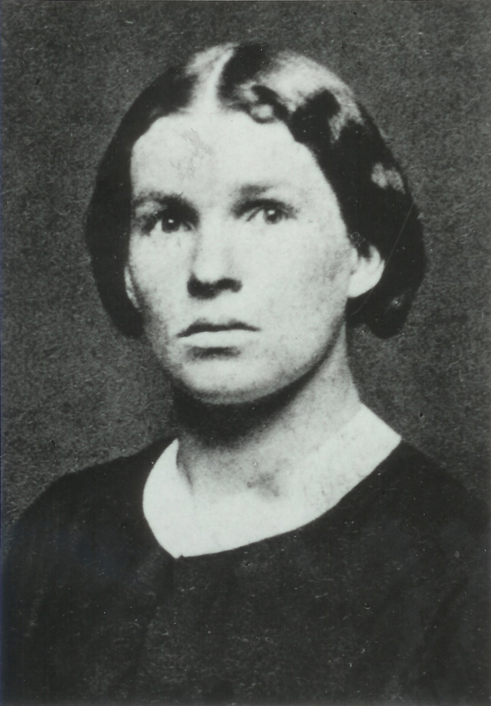
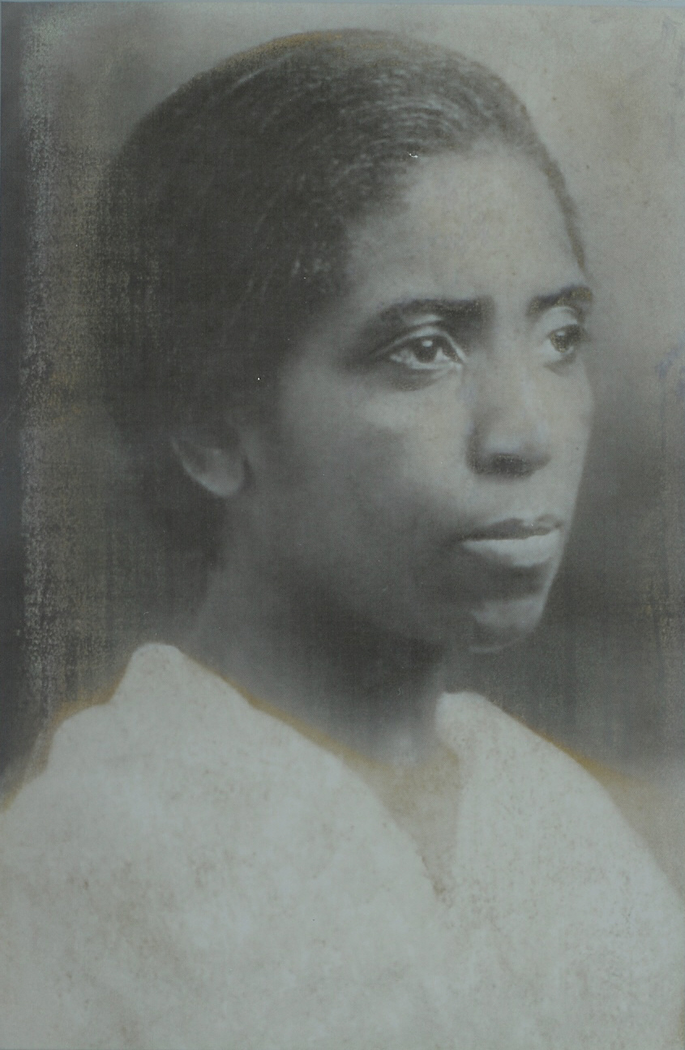
1844 – 1894
Martha D. Byington Amadon
1834 – 1937
Teacher. First Dorcas Society president. Taught in one of the first church schools.
Lottie Blake
1876 – 1976
Physician, founder, missionary. First African-American Seventh-day Adventist woman physician. Established school of nursing at Oakwood College. Helped to treat Ellen White. Missionary in Central America and the Caribbean with husband physician.
Notes:
Martha D. Byington Amadon - 1834 – 1937
Teacher. First Dorcas Society president. Taught in one of the first church schools.
Lottie Blake - 1876 – 1976
Physician, founder, missionary. First African-American Seventh-day Adventist woman physician. Established school of nursing at Oakwood College. Helped to treat Ellen White. Directed the Rock City Sanitarium. With her physician husband, she became a missionary in Central America and the Caribbean.

Slide 8
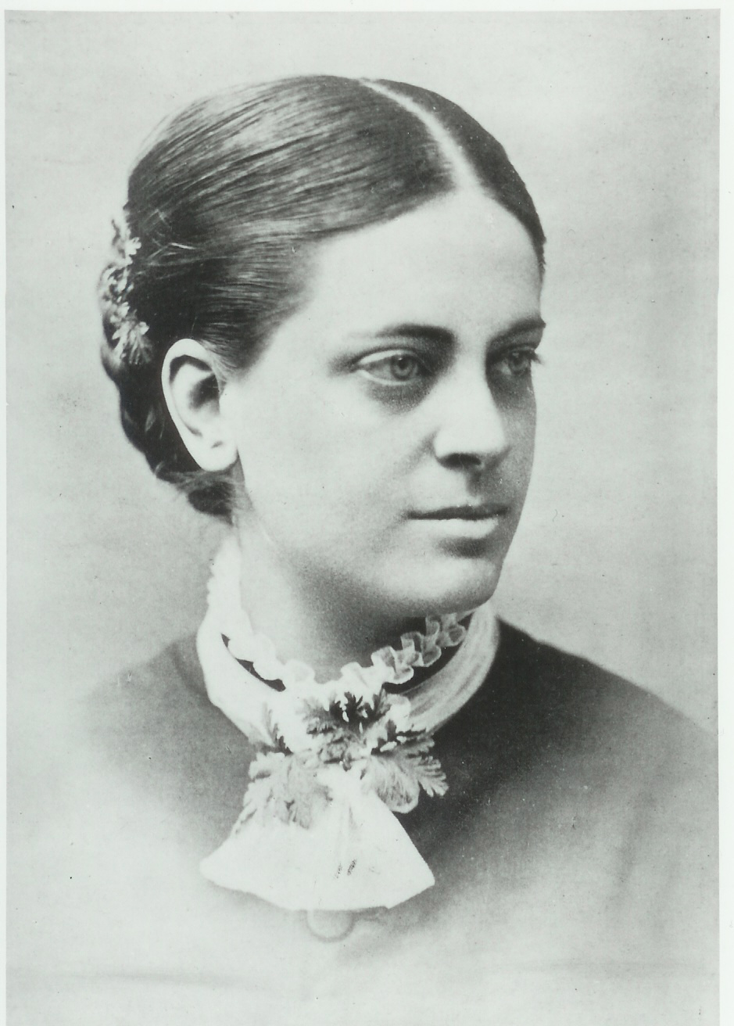
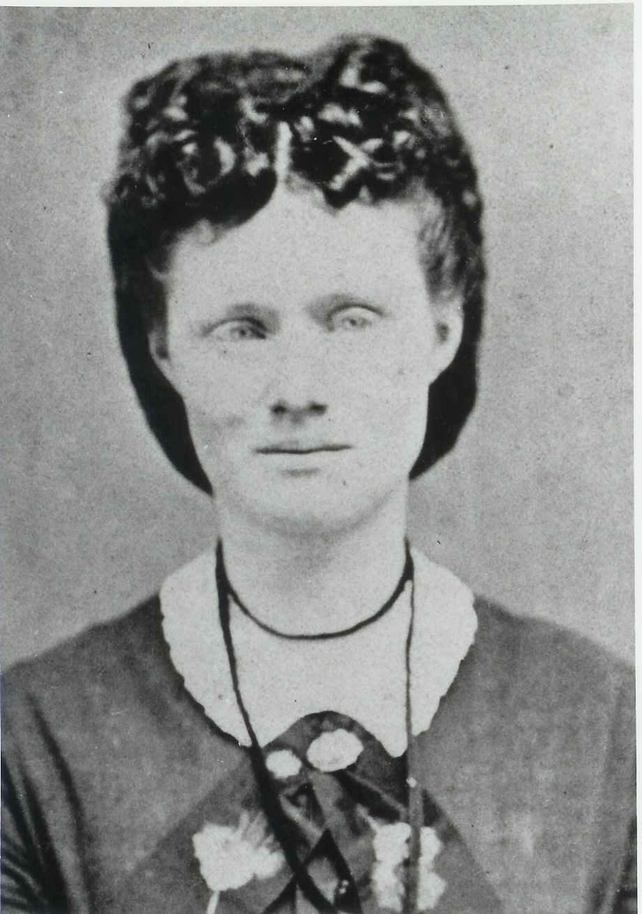
Maud Sisley Boyd
1851 – 1937
Bible instructor, colporteur, educator. First single woman missionary to Europe. Helped J. N. Andrews establish publishing work in Europe. Assisted J. N. Loughborough in pioneer tent evangelism. Served also in Africa and Australia.
Nellie H. Rankin Druillard
1844 – 1937
Financier, treasurer, founder, missionary. Helped found Riverside Sanitarium, Madison College, and Emmanuel Missionary College. Missionary in South Africa.
Notes:
Maud Sisley Boyd - 1851 – 1937
Bible instructor, colporteur, educator. First single woman missionary to Europe. Helped J. N. Andrews establish the publishing work in Europe and assisted J. N. Loughborough in pioneer tent evangelism in England. She married Charles L. Boyd; they were among the first missionaries in South Africa. Their daughter died and he became sick and died shortly after. Maud then went to Australia where she served as matron, preceptress, teacher, and Bible instructor. She continued her work in Loma Linda in retirement.
Nellie H. Rankin Druillard - 1844 – 1937
Financier, treasurer, founder, missionary. A teacher by training and experience, she was one of Adventism's most remarkable women and a particularly able financier. Served as the Nebraska Conference Tract Society Secretary. Later married Alma Druillard; they went to South Africa where she became treasurer and auditor of the conference. She helped found Madison College and served as its treasurer and fiscal advisor for twenty years. Also instrumental in establishing Emmanuel Missionary College, later known as Andrews University. At age 78, she helped found Riverside Sanitarium, singlehandedly organizing the institution and training its workers.

Slide 9
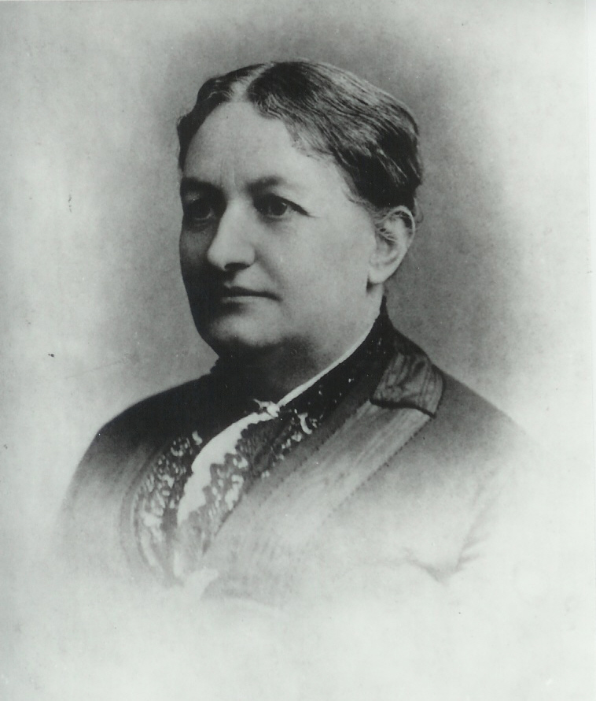
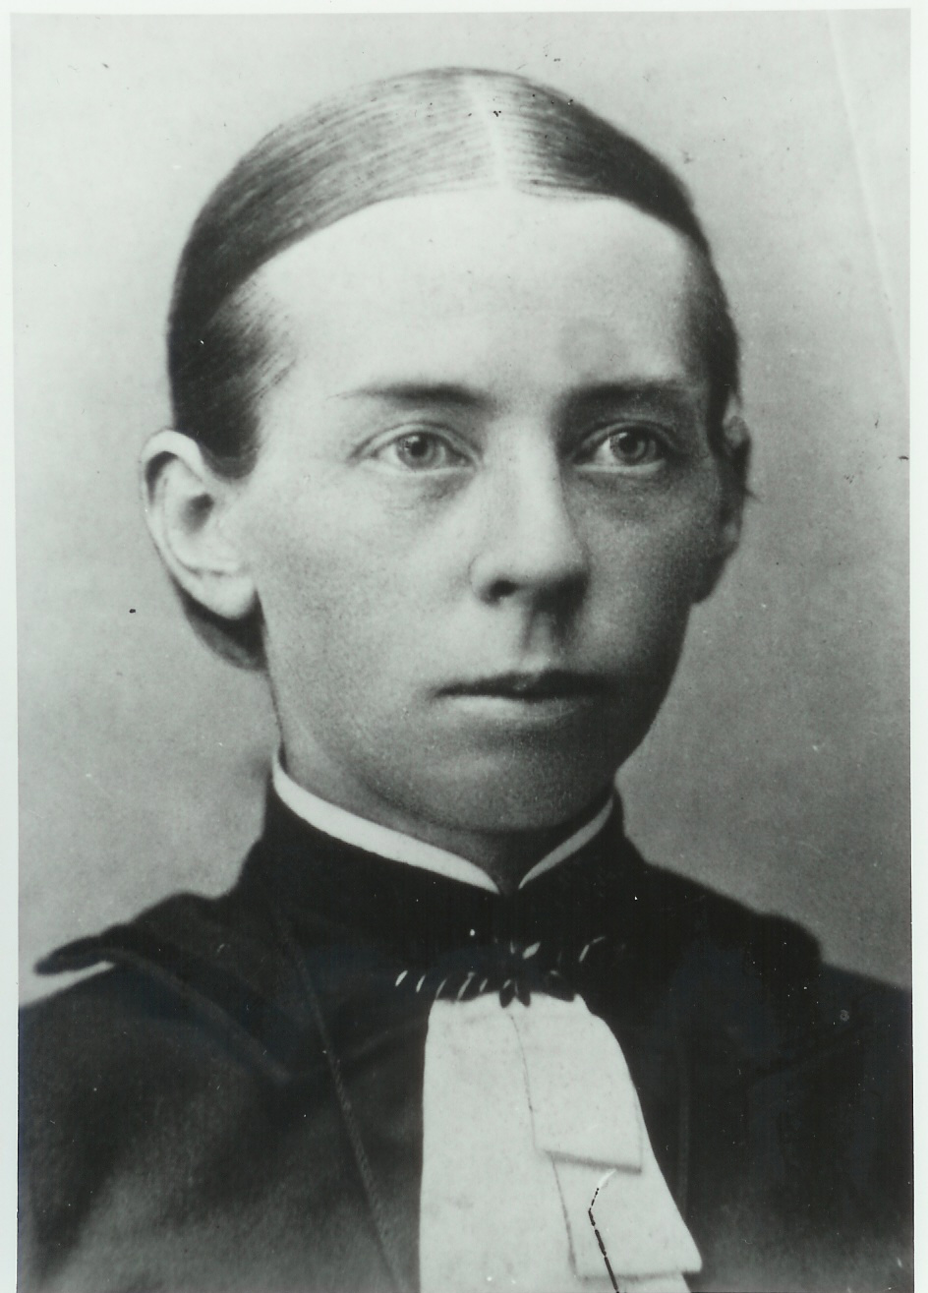
Sarepta Myrenda Irish Henry
1839 – 1900
Temperance activist, personal evangelist, writer. Established first Women’s Ministry in 1898. The General Conference voted her a ministerial license.
Maria L. Huntley
1847 – 1890
Administrator, personal evangelist. President, Tract and Missionary Society which later became Personal Ministries and Publishing department and the Adventist Book Centers.
Notes:
Sarepta Myrenda Irish Henry - 1839 – 1900
Temperance activist, personal evangelist, writer. Established first Women’s Ministry in 1898 at the encouragement of Ellen White, and the General Conference voted her a ministerial license. Unfortunately, she died two years later and her work was not continued for many years. Earlier while recuperating from an illness at the Battle Creek Sanitarium, became a Seventh-day Adventist. She began to correspond with Ellen White, then in Australia. Mrs. White encouraged her to continue her public role with the Women's Christian Temperance Union and her interest in women. Mrs. Henry wrote a weekly column for the Review and Herald on women's ministry and duties while serving as Women’s Ministry leader.
Maria L. Huntley - 1847 – 1890
Administrator, personal evangelist. President, Tract and Missionary Society which later became Personal Ministries, Publishing department, and the Adventist Book Centers. Only woman other than Ellen White to address the 1888 General Conference Session.

Slide 10
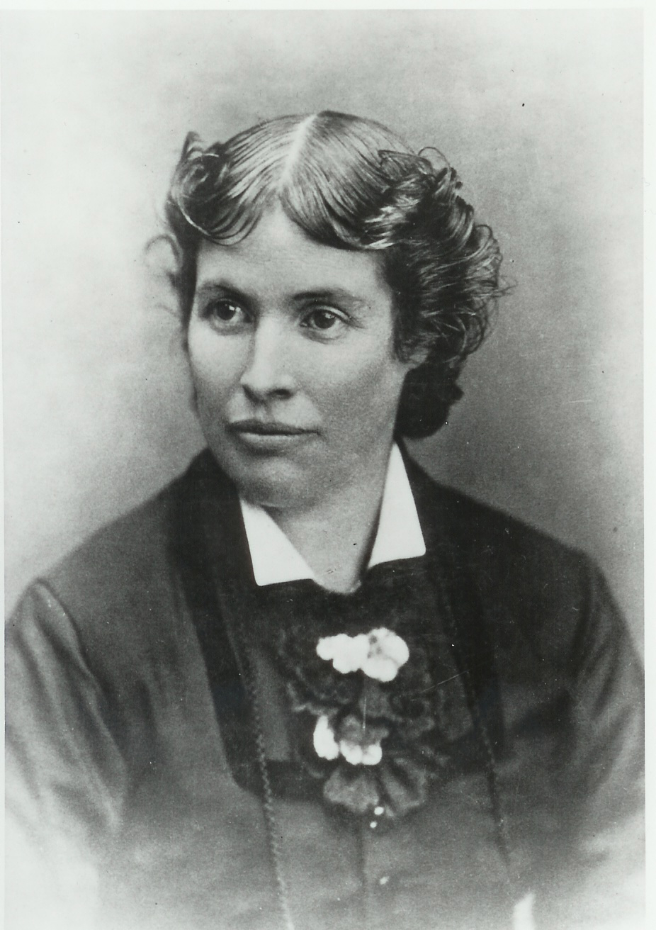
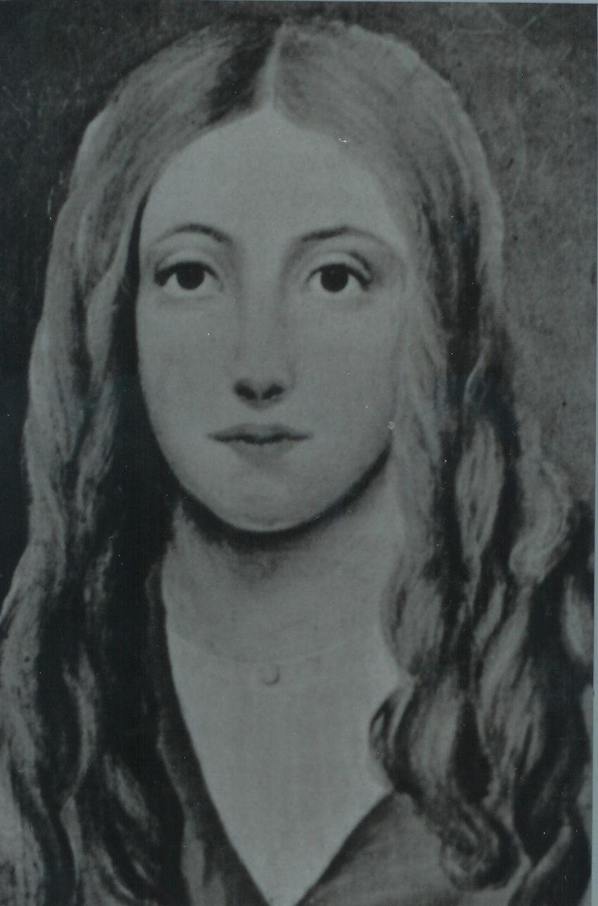
Dr. Katherine (Kate) Lindsey
1842 – 1923
Physician, founder, missionary. Founder of first nurses’ training school at Battle Creek Sanitarium. Missionary in South Africa.
Annie Rebekah Smith
1828 – 1855
Early Advent hymn writer, editor. While James and Ellen White traveled, she published the Advent Review and Sabbath Herald.
Notes:
Dr. Katherine (Kate) Lindsey - 1842 – 1923
Physician, founder, missionary. Physician graduating at the head of her class from the University of Michigan in the second class that accepted female students in the medical school. Founder of first nurses’ training school at Battle Creek Sanitarium in 1883. Served 20 years at Battle Creek and then served at Claremont Sanitarium in South Africa. She practiced at the Colorado Sanitarium in Boulder until retirement.
Annie Rebekah Smith - 1828 – 1855
Early Advent hymn writer, editor. While James and Ellen White traveled, she published the Advent Review and Sabbath Herald. Annie was the older sister of Uriah Smith and the same age as Ellen White. Converted to Adventism by Joseph Bates in 1851. She died of tuberculosis.

Slide 11
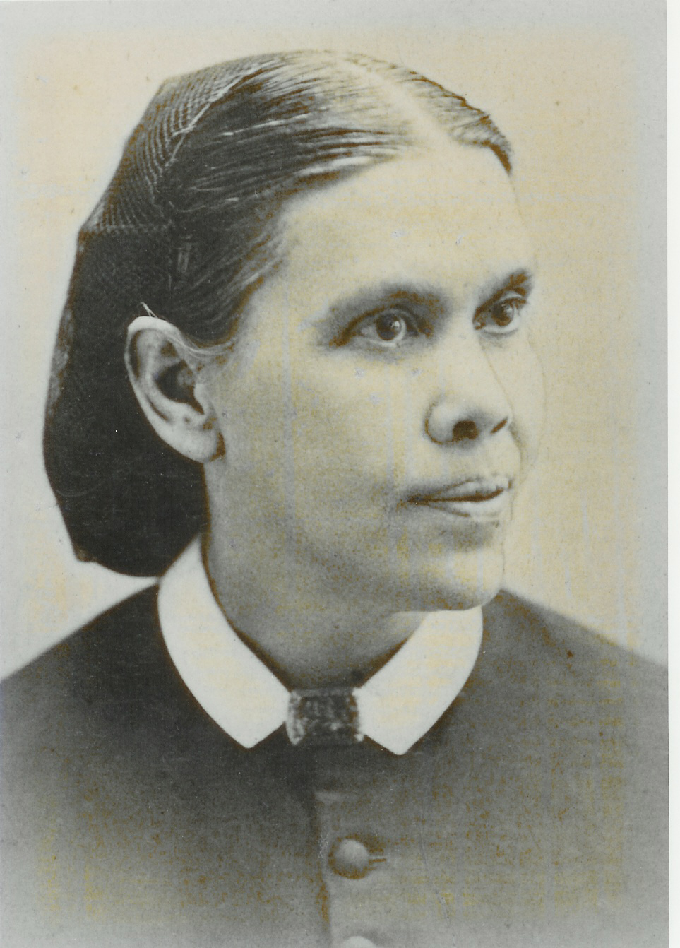
Ellen G. White
1827 – 1915
Early leader and prophetess of the Seventh-day Adventist Church. Author of 126 books and compilations.
Notes:
Ellen G. White - 1827 – 1915
Early leader and prophetess of the Seventh-day Adventist Church. Author of 126 books and compilations.

Slide 12
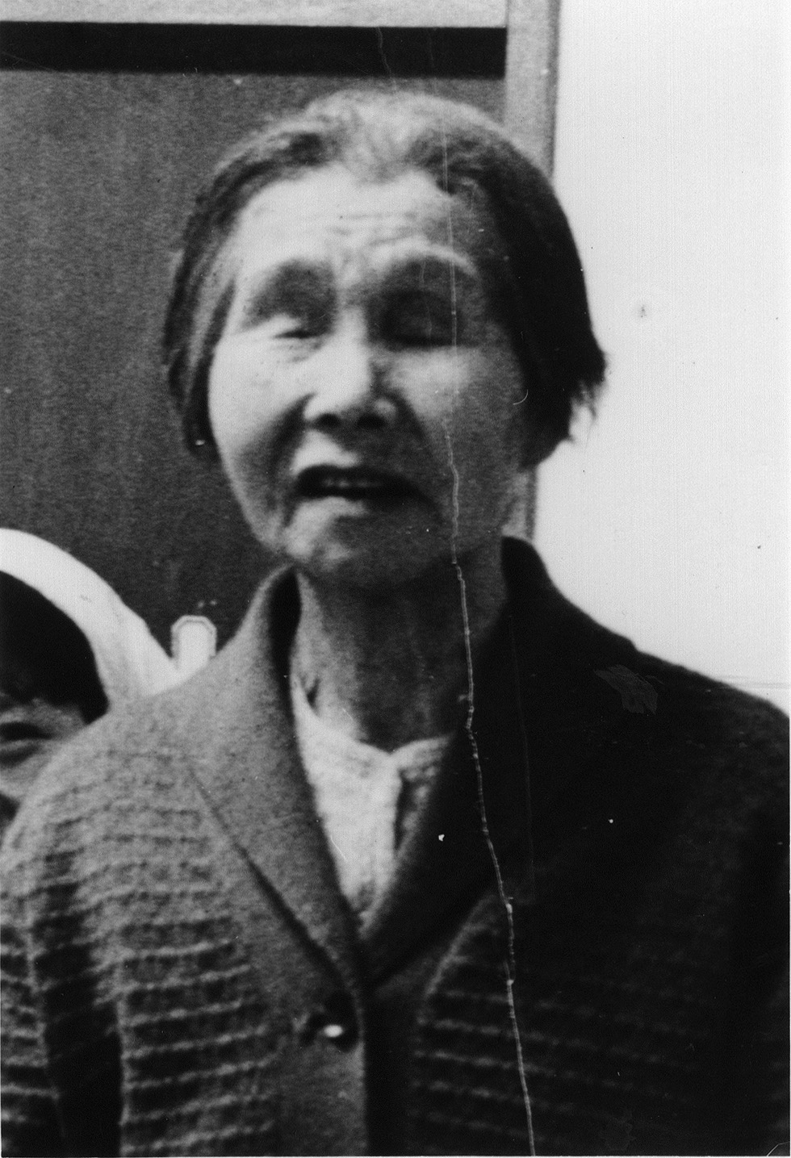
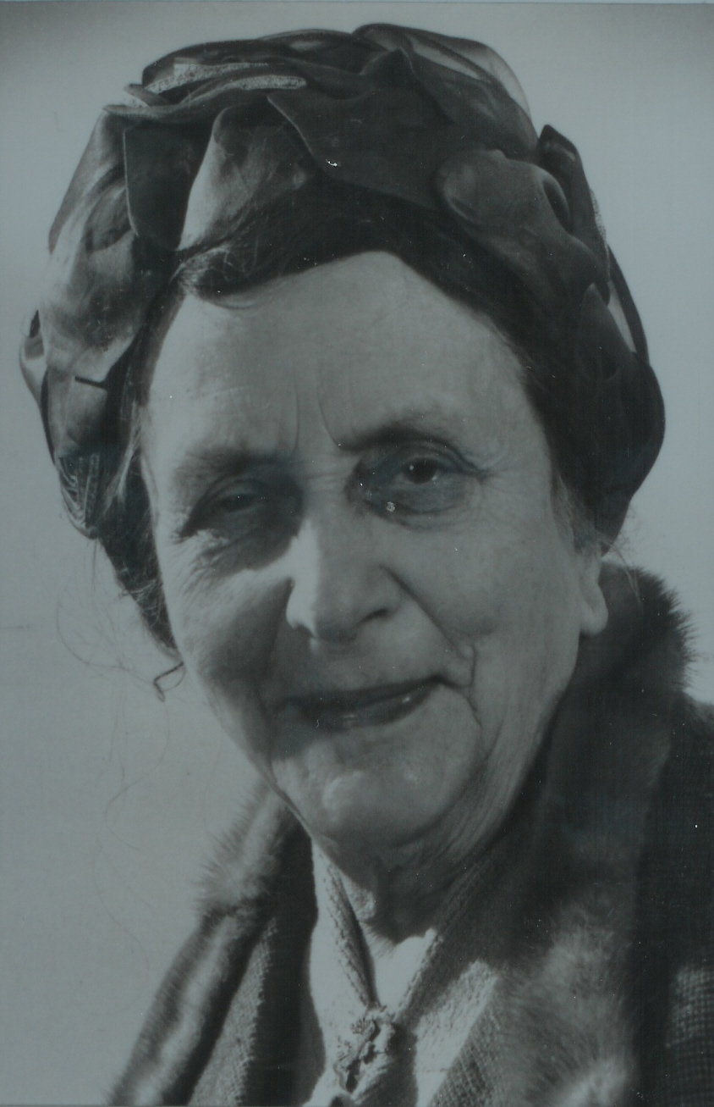
1895 – 1945
Ai Araki
1890 – 1982
Japanese Bible worker, church leader. Although blind, she led and preserved her church throughout World War II, the only congregation in Japan to remain intact.
Dr. Gertrude Brown
1866 – 1948
English physician, founder. Pioneered medical work in the British Isles. Established sanitarium in Crieff, Scotland. Worked with J. Harvey Kellogg.
Notes:
Ai Araki - 1890 – 1982
Japanese Bible worker, church leader. Although blind, she led and preserved her church throughout World War II, the only congregation in Japan to remain intact.
Dr. Gertrude Brown - 1866 – 1948
English physician, founder. Pioneered medical work in the British Isles. Established sanitarium in Crieff, Scotland. Worked with J. Harvey Kellogg.

Slide 13
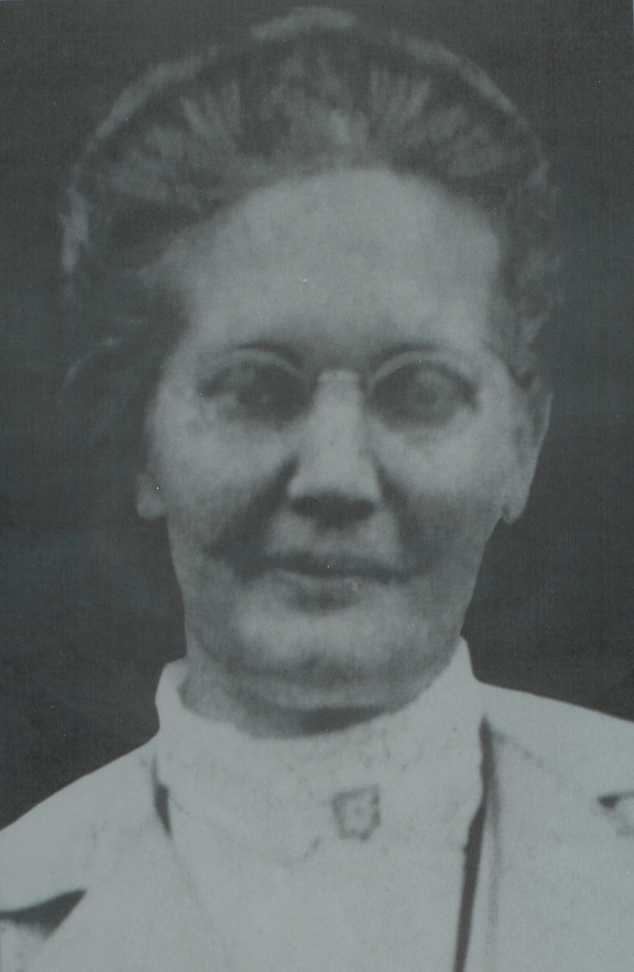
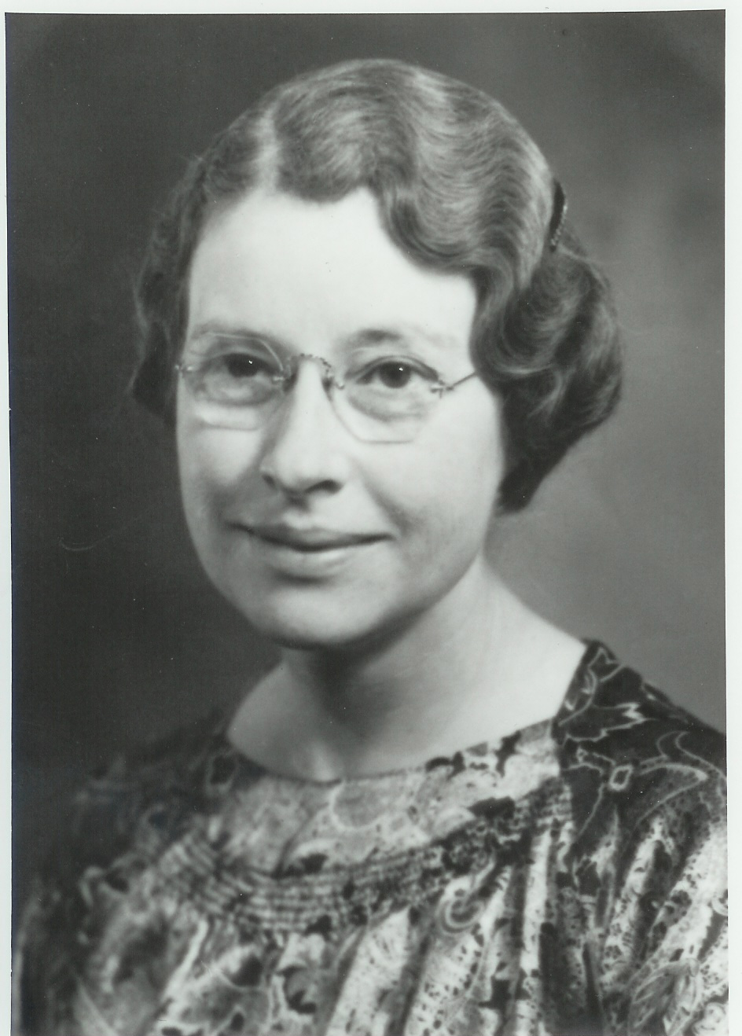
Georgia Burrus Burgess
1866 – 1948
Educator, frontier missionary in India. Opened a school in Calcutta. Ministered for 40 years, especially to women.
Lora E. Clement
1890 – 1958
Associate editor and editor of Youth’s Instructor for 41 years.
Notes:
Georgia Burrus Burgess - 1866 – 1948
Educator, frontier missionary in India. Ministered for 40 years, especially to women. Opened a school in Calcutta. She was prepared to go to India as a missionary with only $1; fortunately, someone gave her $80 more. The first year she served alone as self-supporting missionary.
Lora E. Clement - 1890 – 1958
Associate editor and editor of Youth’s Instructor for 41 years.

Slide 14
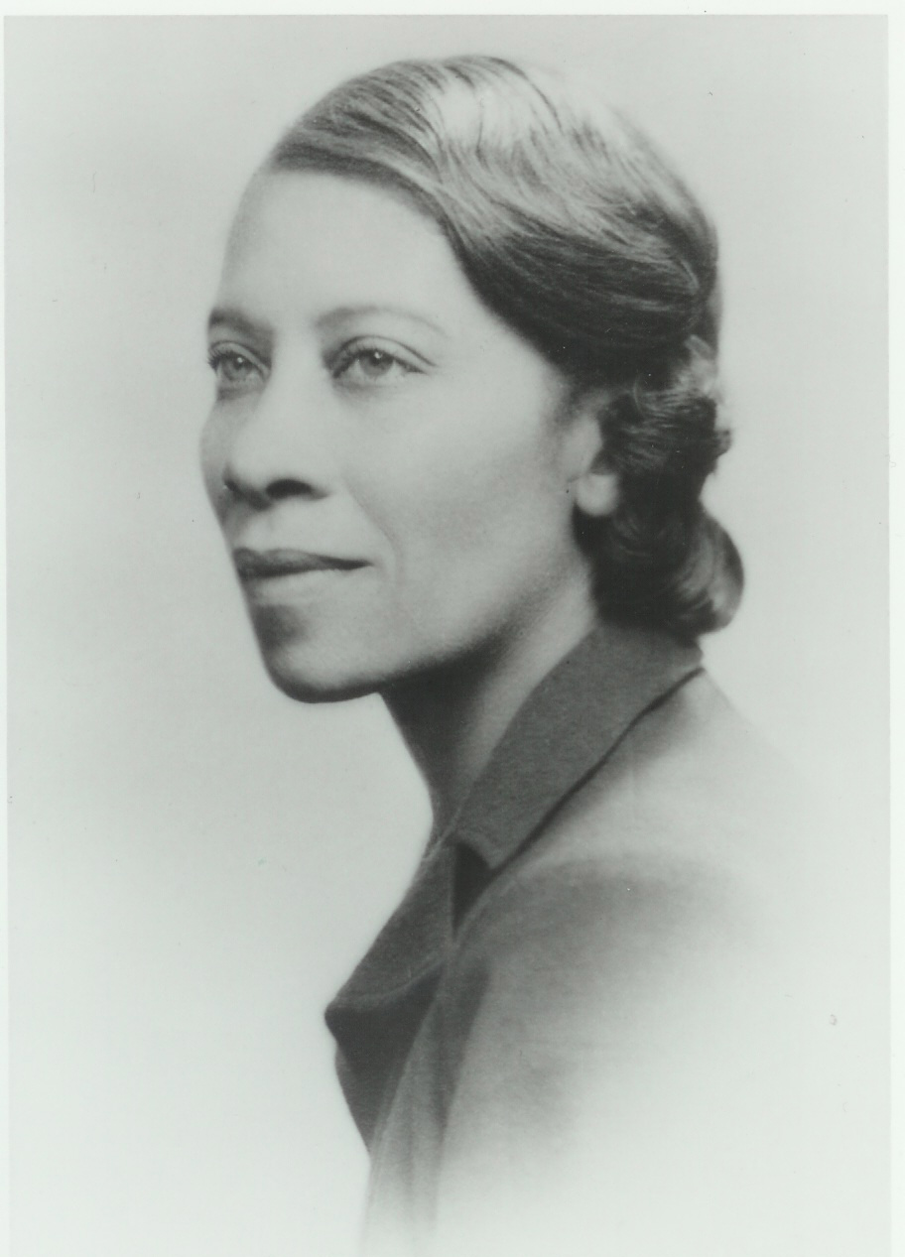
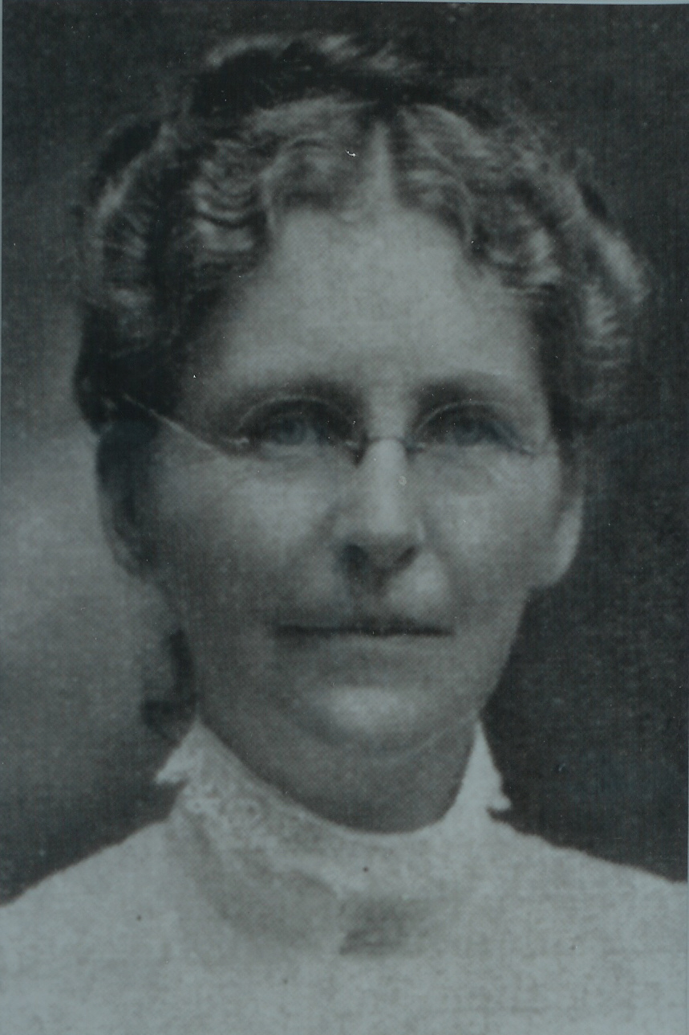
Dr. Eva Dykes
1893 – 1986
Musician, educator. First Seventh-day Adventist woman to receive a Ph.D. in the United States.
Anna L. Ingels Hindson
1862 – 1933
Editor, union secretary-treasurer, union departmental director for Youth and Sabbath School. Missionary in Australia.
Notes:
Dr. Eva Dykes - 1893 – 1986
Musician, educator. First Seventh-day Adventist woman to receive a Ph.D. in the United States, graduating from Radcliffe in 1921. Taught at Walden and Howard Universities and Oakwood College.
Anna L. Ingels Hindson – 1862-1933
Editor, union secretary-treasurer, union departmental director. Missionary in Australia. Editor of the Missionary Leader for 18 years and Australasian Record for 34 years. Served eight years as the union secretary of the Young People's Department (a position now called union departmental director for Youth Ministries) and 30 years as secretary of the Australasian Union Sabbath School Department.

Slide 15
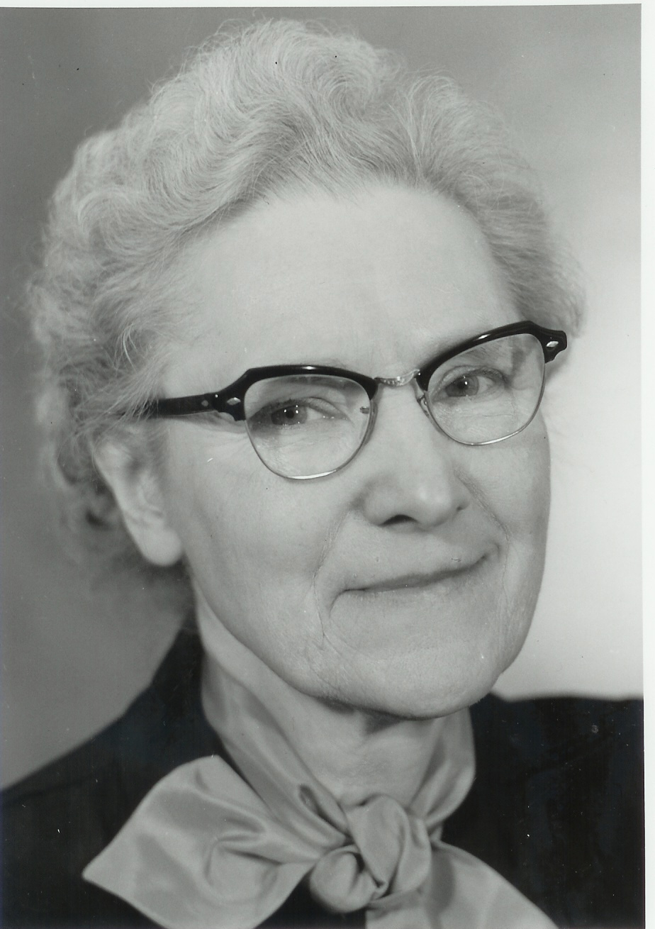
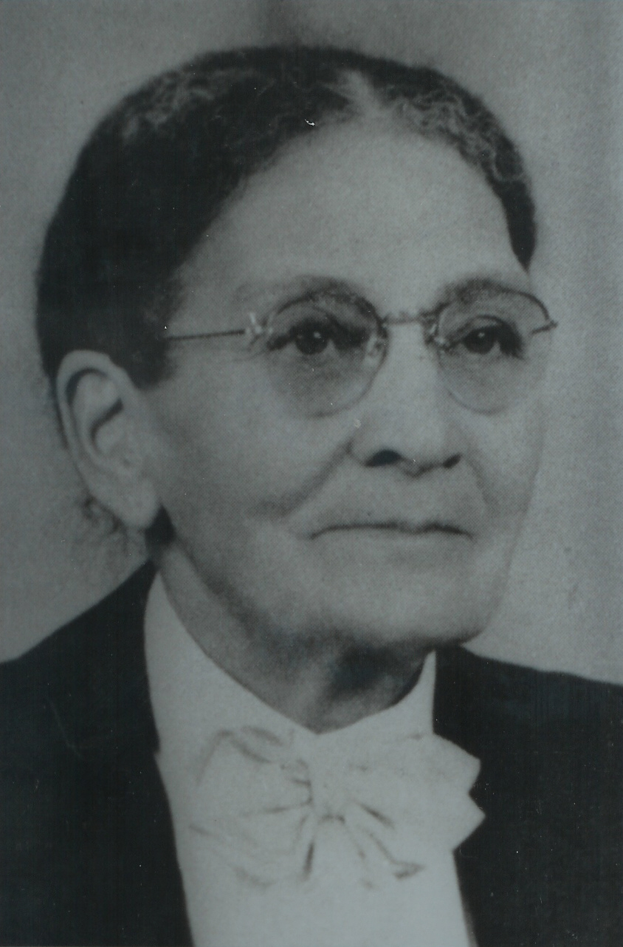
Louise Kleuser
1890 – 1976
Bible worker, pastor, evangelist, editor, seminary professor. Conference director of Education; associate secretary of the General Conference Ministerial Association, an editor of the Ministry magazine.
Anna Knight
1874 – 1972
Nurse, educator, Bible worker. First African-American woman missionary. Conference and union departmental director. Served in India and the United States.
Notes:
Louise Kleuser - 1890 – 1976
Bible worker, pastor, evangelist, editor, seminary professor. Conference departmental director of Education; associate secretary of the General Conference Ministerial Association, and an editor of the Ministry magazine.
Anna Knight - 1874 – 1972
Nurse, educator, Bible worker. First African-American woman missionary, serving in India. Upon her return to the US, she served as conference and union departmental secretary. In 1940 she was appointed to the General Conference North American Negro Department. The daughter of ex-slave sharecroppers, she read herself into the Adventist faith through the Signs of the Times. Graduated in nursing from Battle Creek College in 1898. Built a self-supporting school for Blacks in Mississippi.

Slide 16
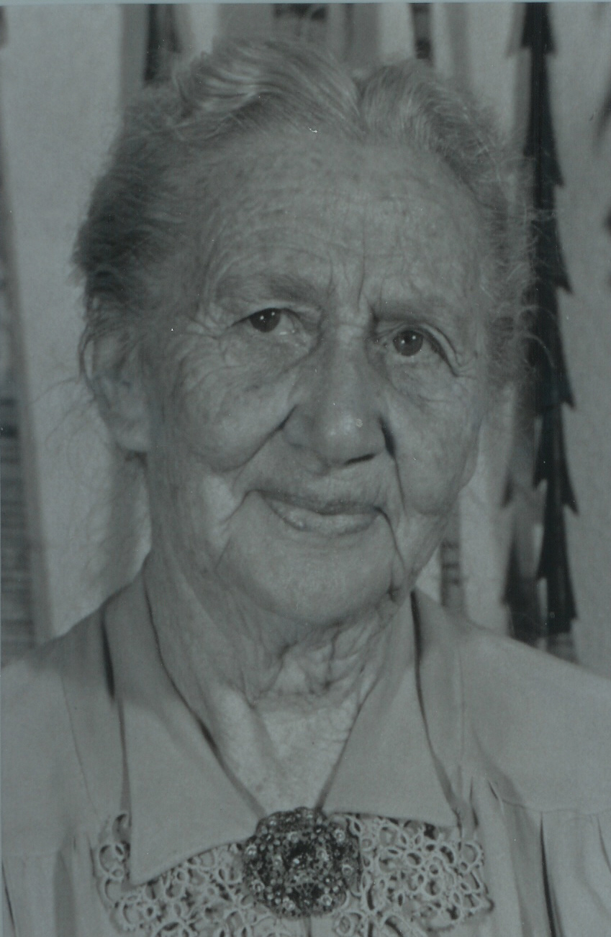
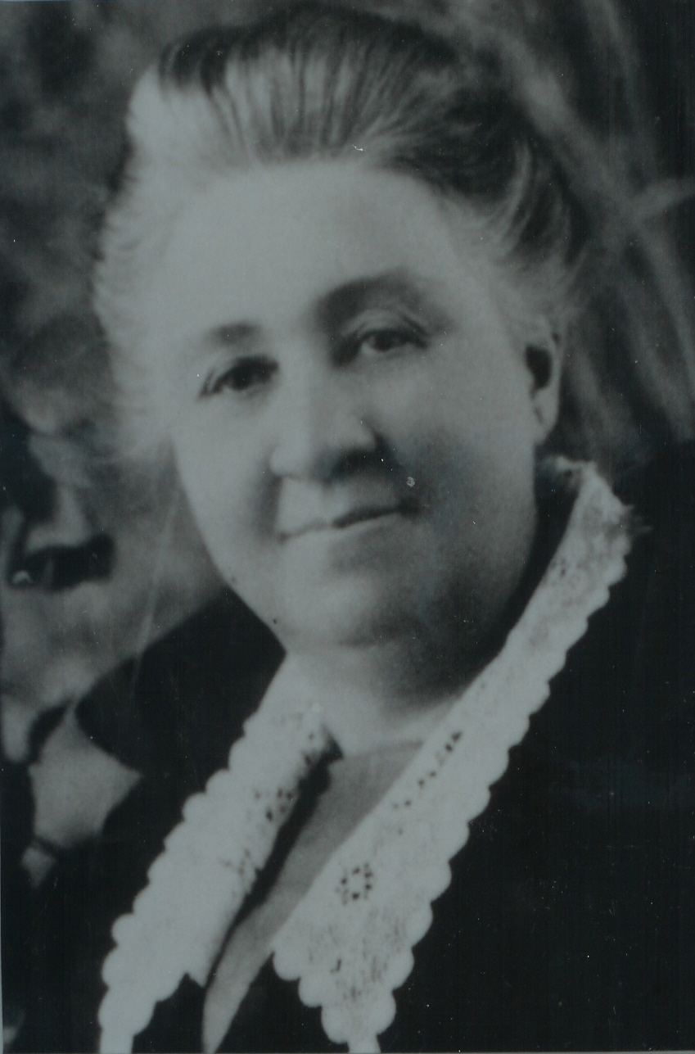
Ana Stahl
1870 – 1968
Swedish nurse, educator. Pioneer missionary in South America with her husband for 29 years. Instrumental in establishing Indian church schools.
Marinda (Minnie) Day Sype
1869 – 1956
Pastor, evangelist, licensed minister for 54 years. Conference departmental director.
Notes:
Ana Stahl - 1870 – 1968
Swedish nurse, educator. Pioneer missionary in South America with her husband for 29 years. Instrumental in establishing Indian church schools.
Marinda (Minnie) Day Sype - 1869 – 1956
Pastor, evangelist, licensed minister for 54 years. Conference director for Home Missionary department. Served in Iowa, Oklahoma, Pennsylvania, Washington, Oregon, Idaho, and Florida conferences, and the Bahamas​.

Slide 17
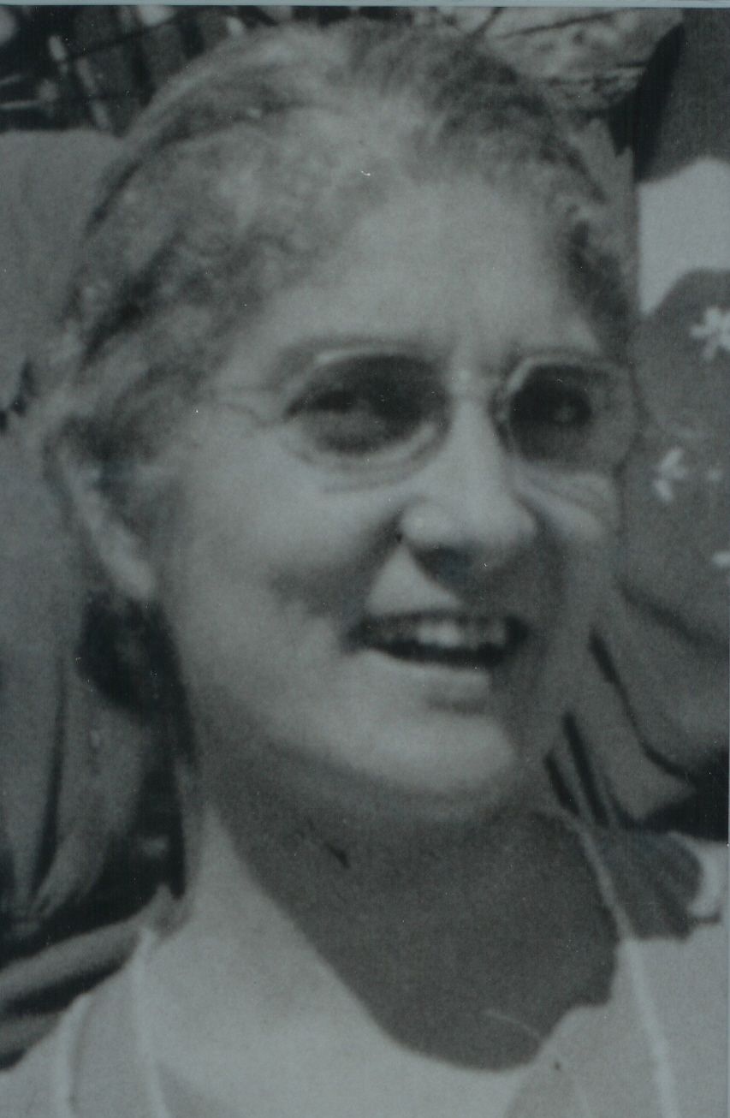
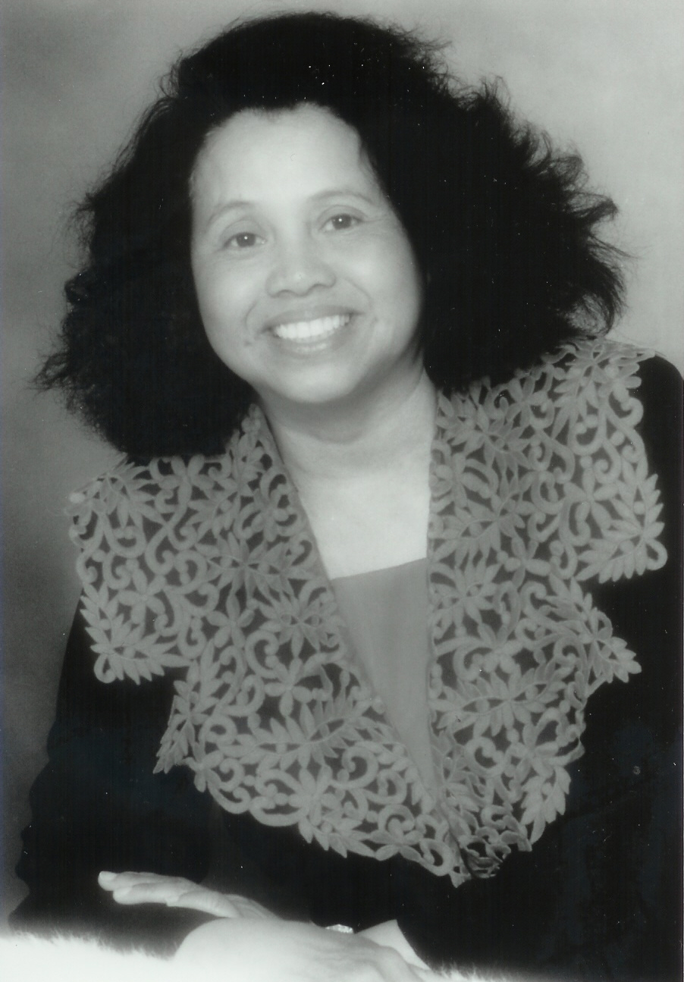
1946 – 1996
Ana Rosa Alvarado
Cuban pastor, evangelist, educator, musician for 45 years. Raised numerous churches and reputedly preached in every congregation in Cuba.
Dr. Nancy Bassham
Thai educator converted from Buddhism. First director of Family Life and Women’s Ministries in the Asia-Pacific Division.
Notes:
1946 – 1996
Ana Rosa Alvarado
Cuban pastor, evangelist, educator, musician for 45 years. Raised numerous churches and reputedly preached in every congregation in Cuba.
Dr. Nancy Bassham
Thai educator converted from Buddhism who returned as a missionary to her people. First division departmental director of Family Life and Women’s Ministries in the Asia-Pacific Division.

Slide 18
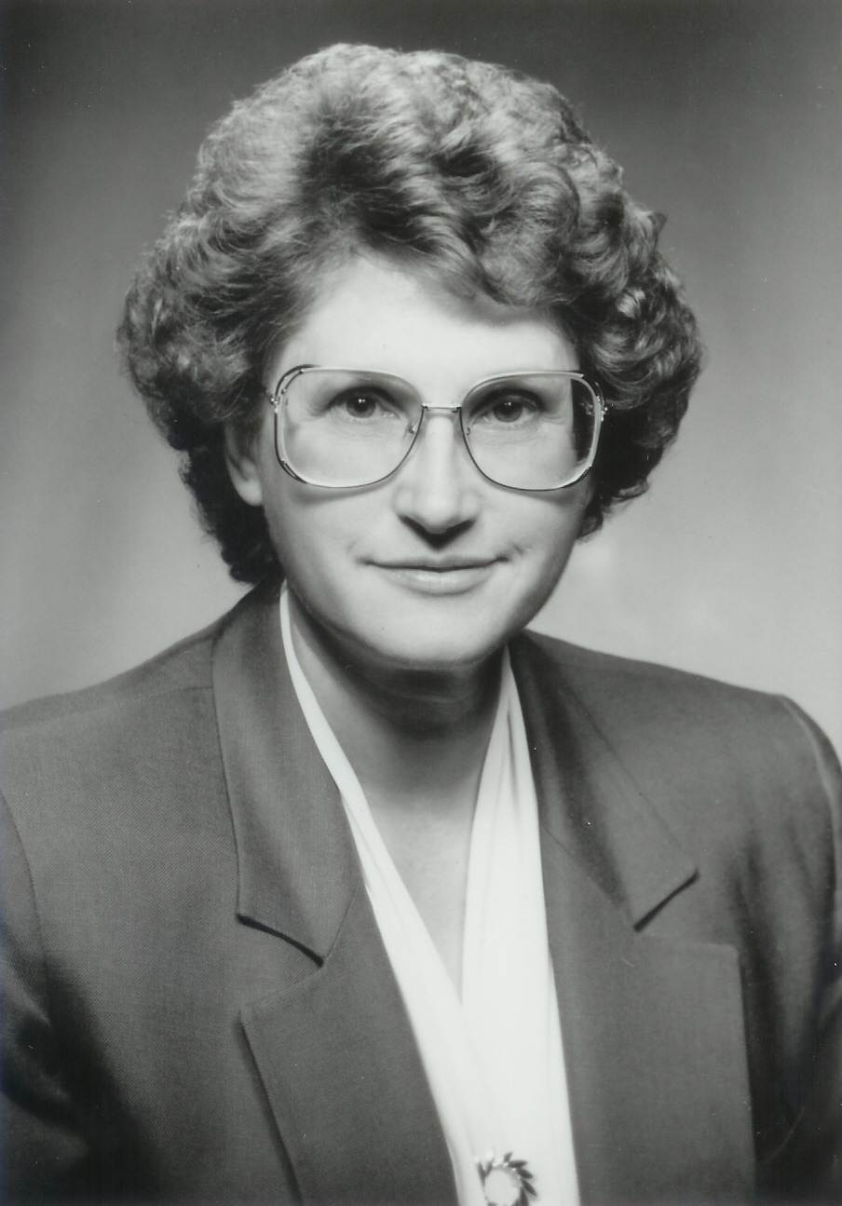
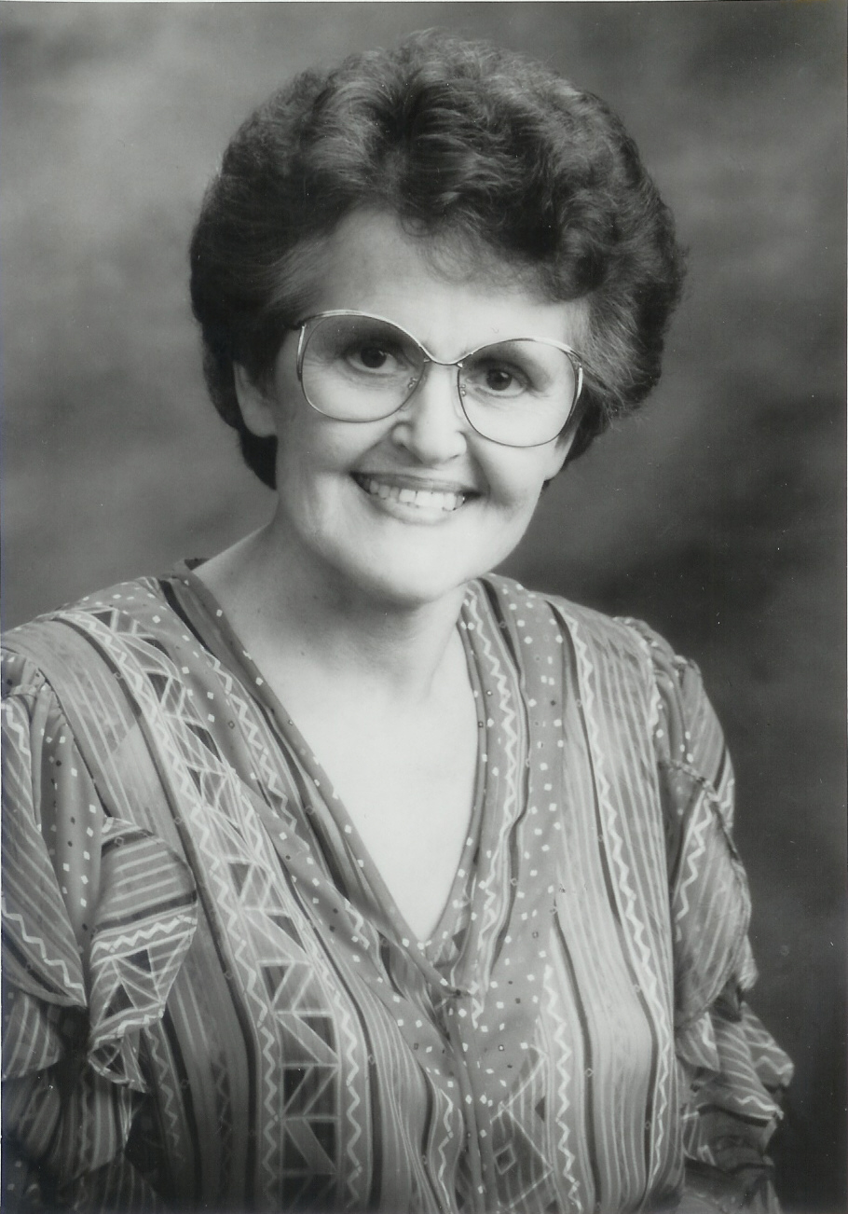
Dr. Lyn Behrens
Australian physician. First woman president of Loma Linda University.
Del Delker
1924 – 2018
Musician. Contralto soloist for the Voice of Prophecy radio broadcast with 70 recording and 32 solo albums.
Notes:
Lyn Behrens
Australian physician. First woman president of Loma Linda University.
Del Delker - 1924 – 2018
Musician. Contralto soloist for the Voice of Prophecy radio broadcast with 70 recording and 32 solo albums.

Slide 19
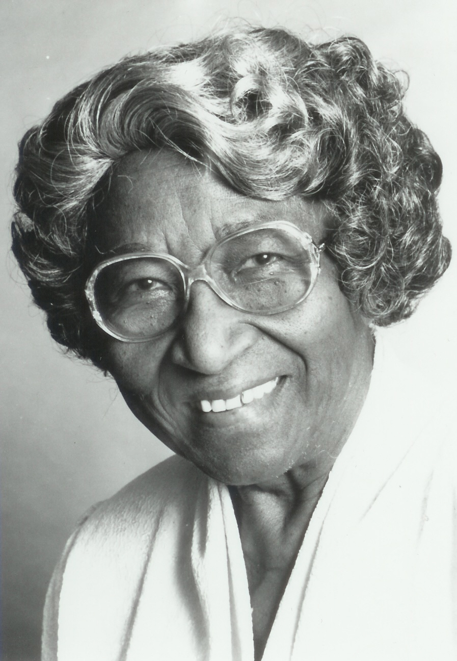
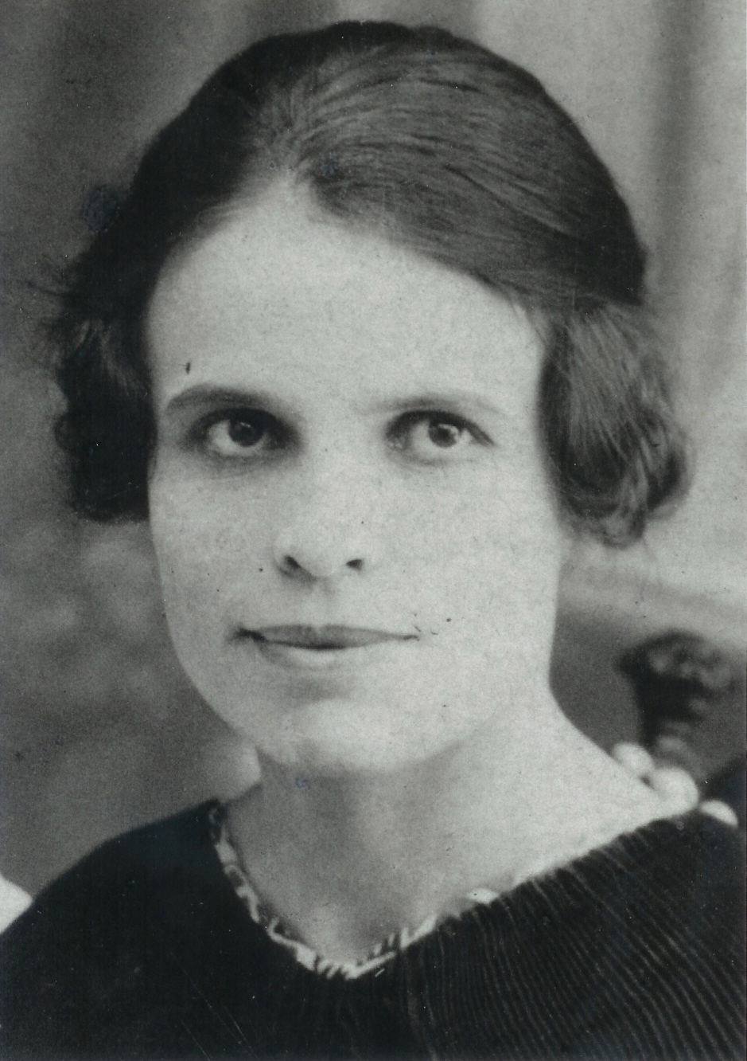
Chessie Harris
1906-1997
Educator, humanitarian. More than 1200 children have received care at the
Harris Home.
Jessie Halliwell
Missionary nurse. With her pilot husband, supplied the only medical care to thousands along the Amazon River for 38 years.
Notes:
Chessie Harris - 1906-1997
Educator, humanitarian. More than 1200 children have received care at the Harris Home in Huntsville, Alabama. Recognized in 1987 as one of America's Unsung Heroines, she was also honored by President George W. H. Bush.
Jessie Halliwell
Missionary nurse. With her pilot husband, supplied the only medical care to thousands along the Amazon River for 38 years.

Slide 20
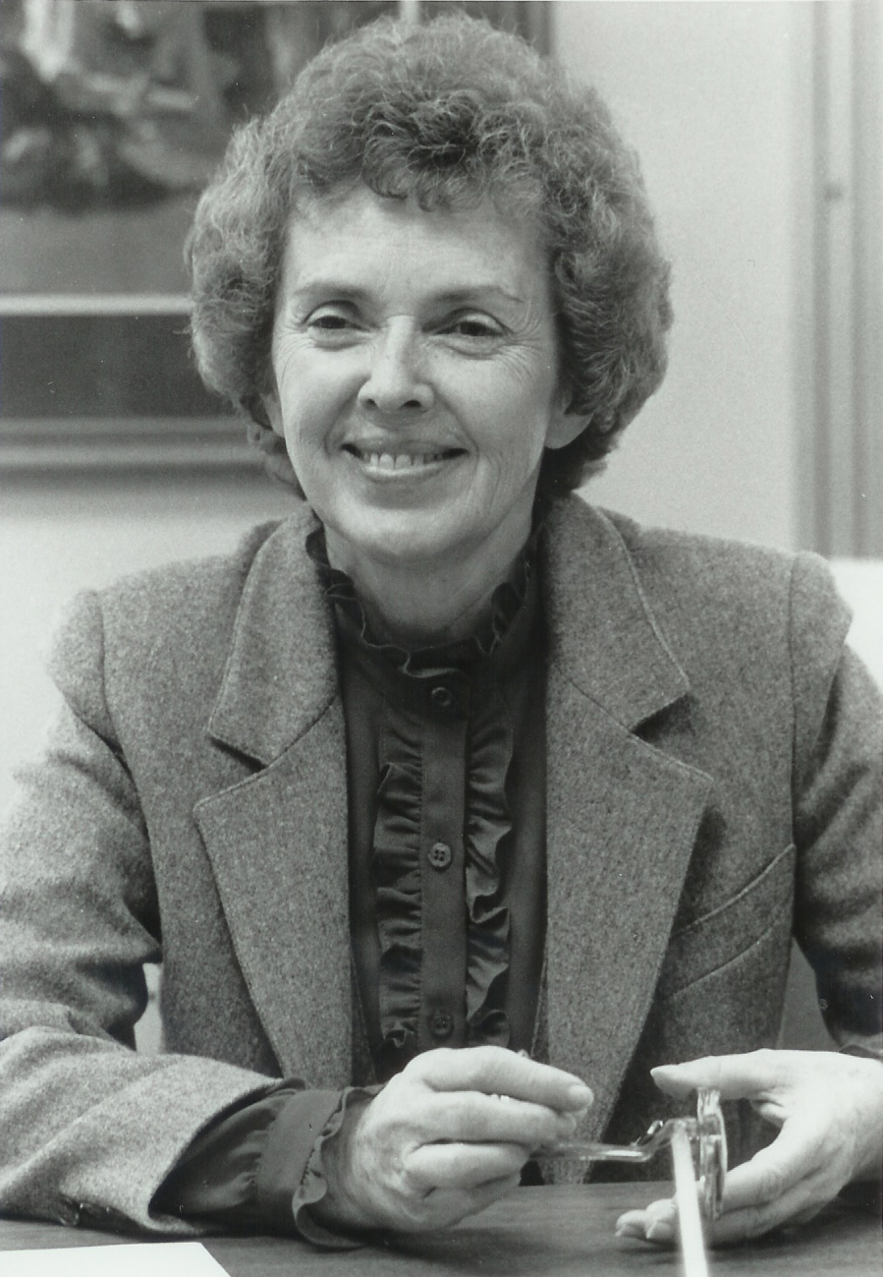
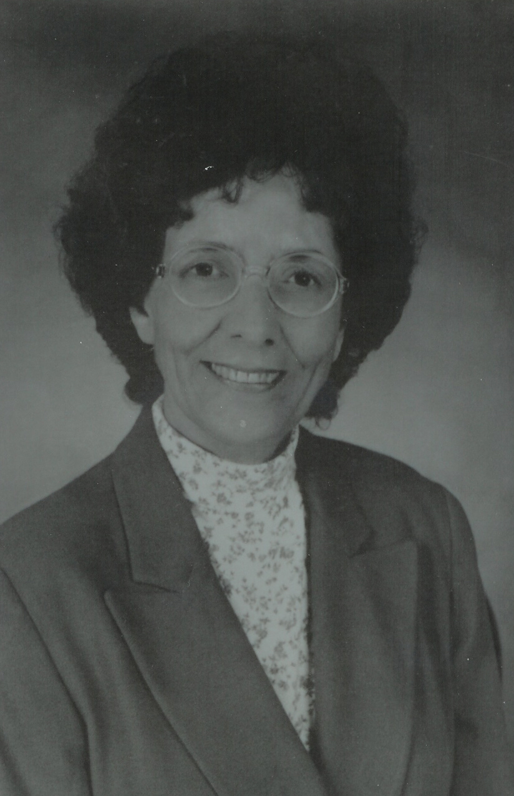
Betty Holbrook
1924 – 1996
Teacher, author, missionary to South America. Chairperson of first Women’s Ministries Advisory. General Conference Home and Family Service director and Church Ministries assistant director.
Juanita Kretschmar
Humanitarian, prayer warrior, speaker. Started New York City Van Ministry and Good News Network.
Notes:
Betty Holbrook (d. 1996)
Teacher, author, missionary to South America. Chairperson of first Women’s Ministries Advisory. General Conference Home and Family Service director and GC Church Ministries associate director.
Juanita Kretschmar
Humanitarian, prayer warrior, speaker. Started New York City Van Ministry and Good News Network.

Slide 21
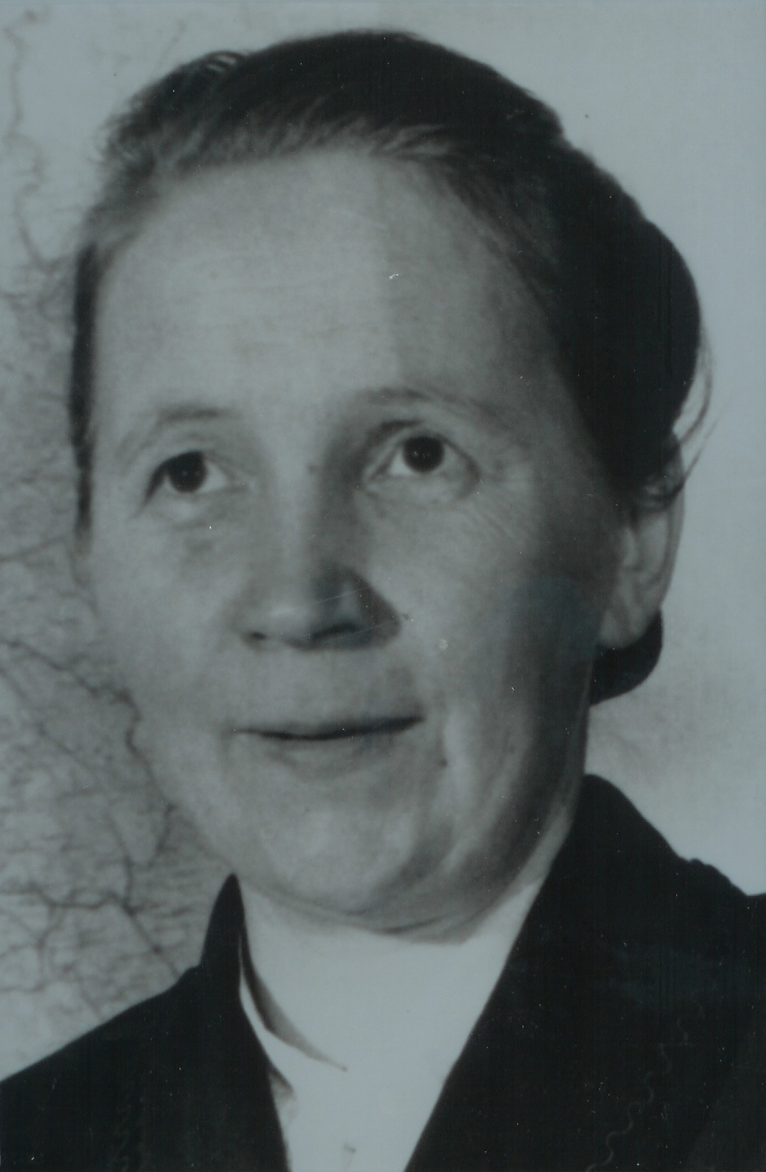
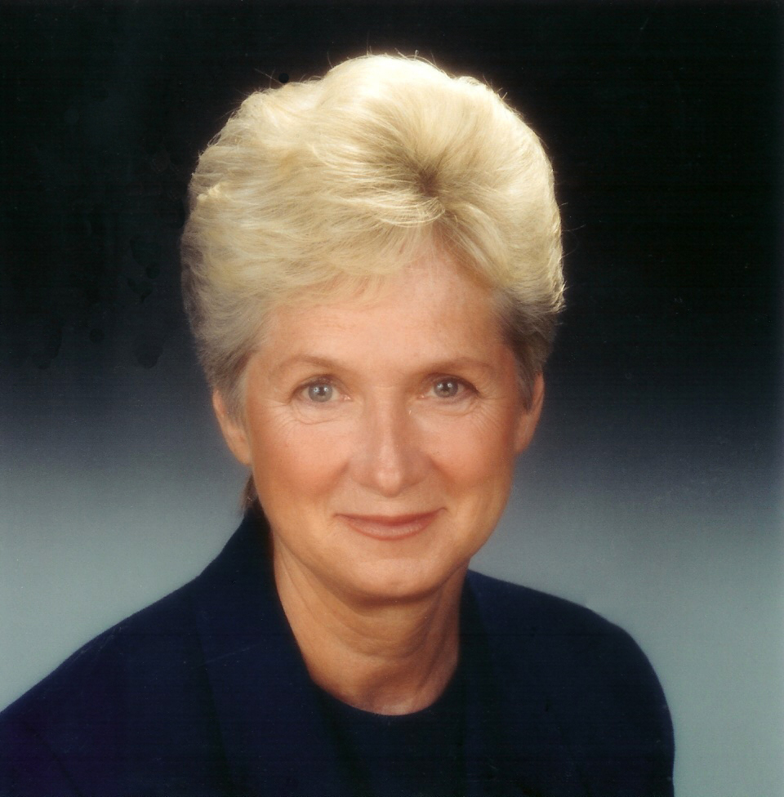
Elsa Luukkanan
1916 – 1996
Finnish evangelist and pastor. When male pastors were drafted during WWII, she and other women carried on with the pastoring responsibilities of Finland.
Rose Otis
First director of General Conference Women’s Ministries Office and Department, 1990-1996. General Conference general field secretary.
Notes:
Elsa Luukkanan – 1916 – 1996
Very successful Finnish evangelist and pastor. She and other women carried especially heavy burdens during WWII when the male pastors were drafted. In 1968 the Finnish Union leaders inquired about the possibility of ordaining these women; this was one of the factors leading to the 1973 Mohaven meeting.
Rose Otis
First director of General Conference Women’s Ministries Office and Department. General Conference general field secretary. Vice President for North American Division and Texas Conference.

Slide 22
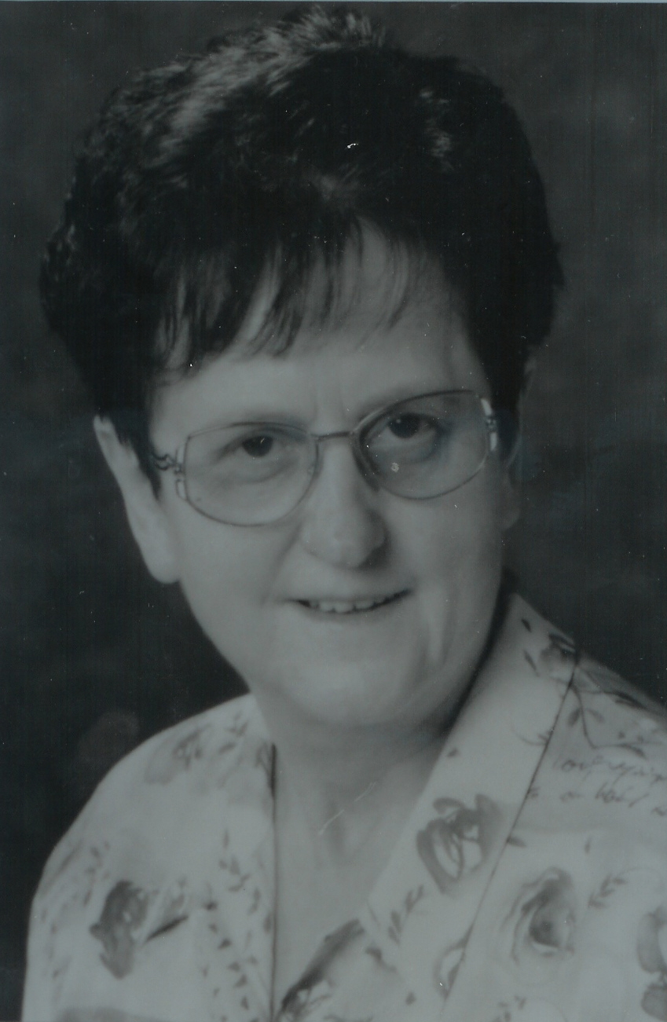
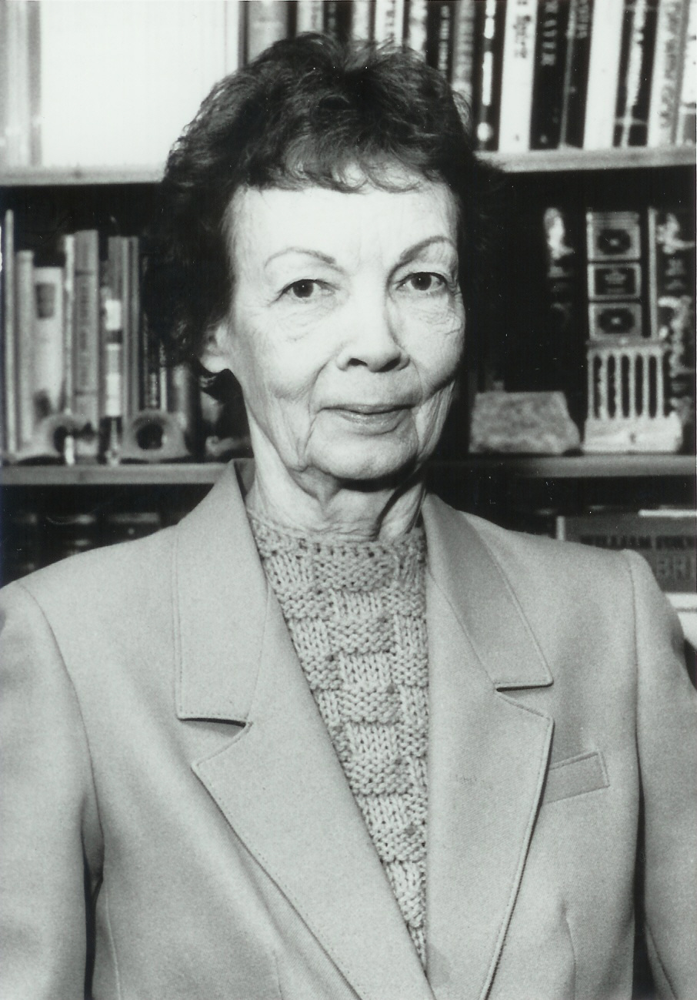
Margarete Prange
German pastor, evangelist. Effective mentor to young ministers who interned under her. Member of the 1989 Women’s Commission.
Dr. Leona Running
1917 – 2014
Professor of ancient languages at the Seventh-day Adventist Theological Seminary for more than 40 years. Knew 17 languages.
Notes:
Margarete Prange
German pastor and evangelist. Because of her effective leadership, young ministers often interned under her. Her success as a pastor led conference leaders to ask about ordaining her, one of the factors that led to calling the Council on the Role of Women in the Church at Camp Mohaven in 1973. A member of the 1989 Women’s Commission.
Dr. Leona Running – 1917 – 2014
Professor of ancient languages at the Seventh-day Adventist Theological Seminary for more than 40 years. She knew 17 languages and taught most Adventist ministers who have passed through the seminary during those 40-plus years. Began her service for the Church at the Voice of Prophecy and as copy editor for Ministry magazine.

Slide 23
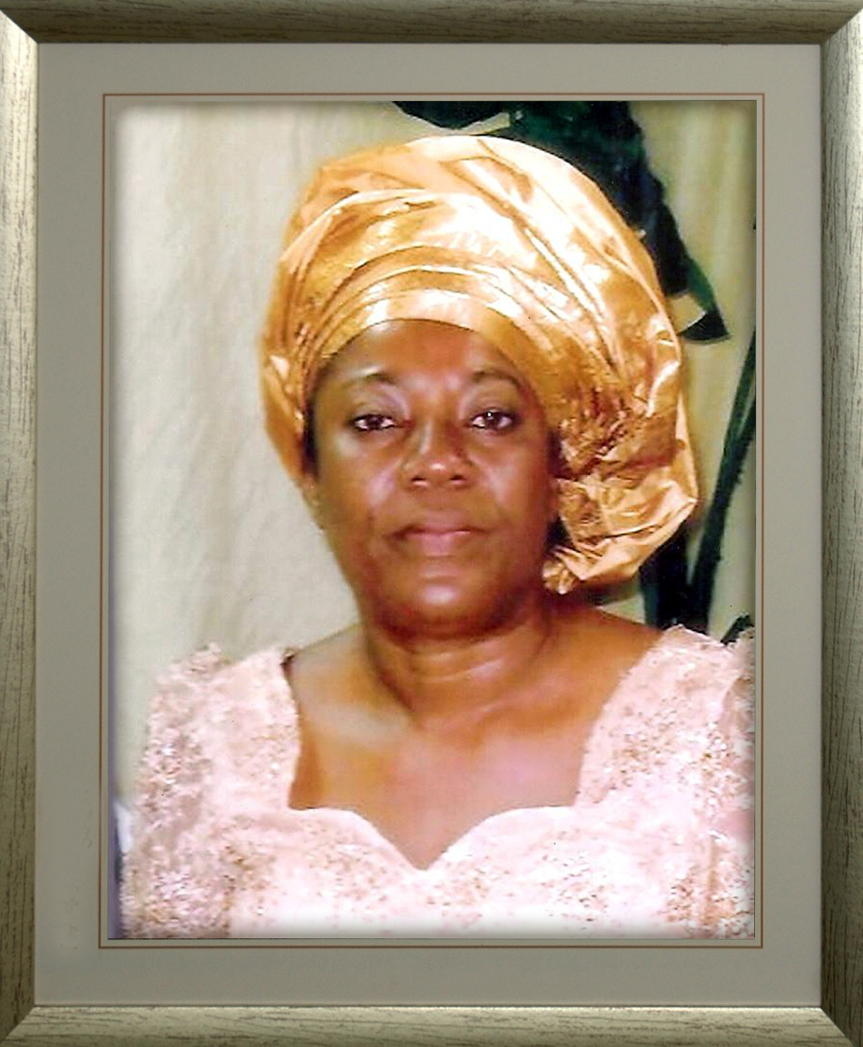
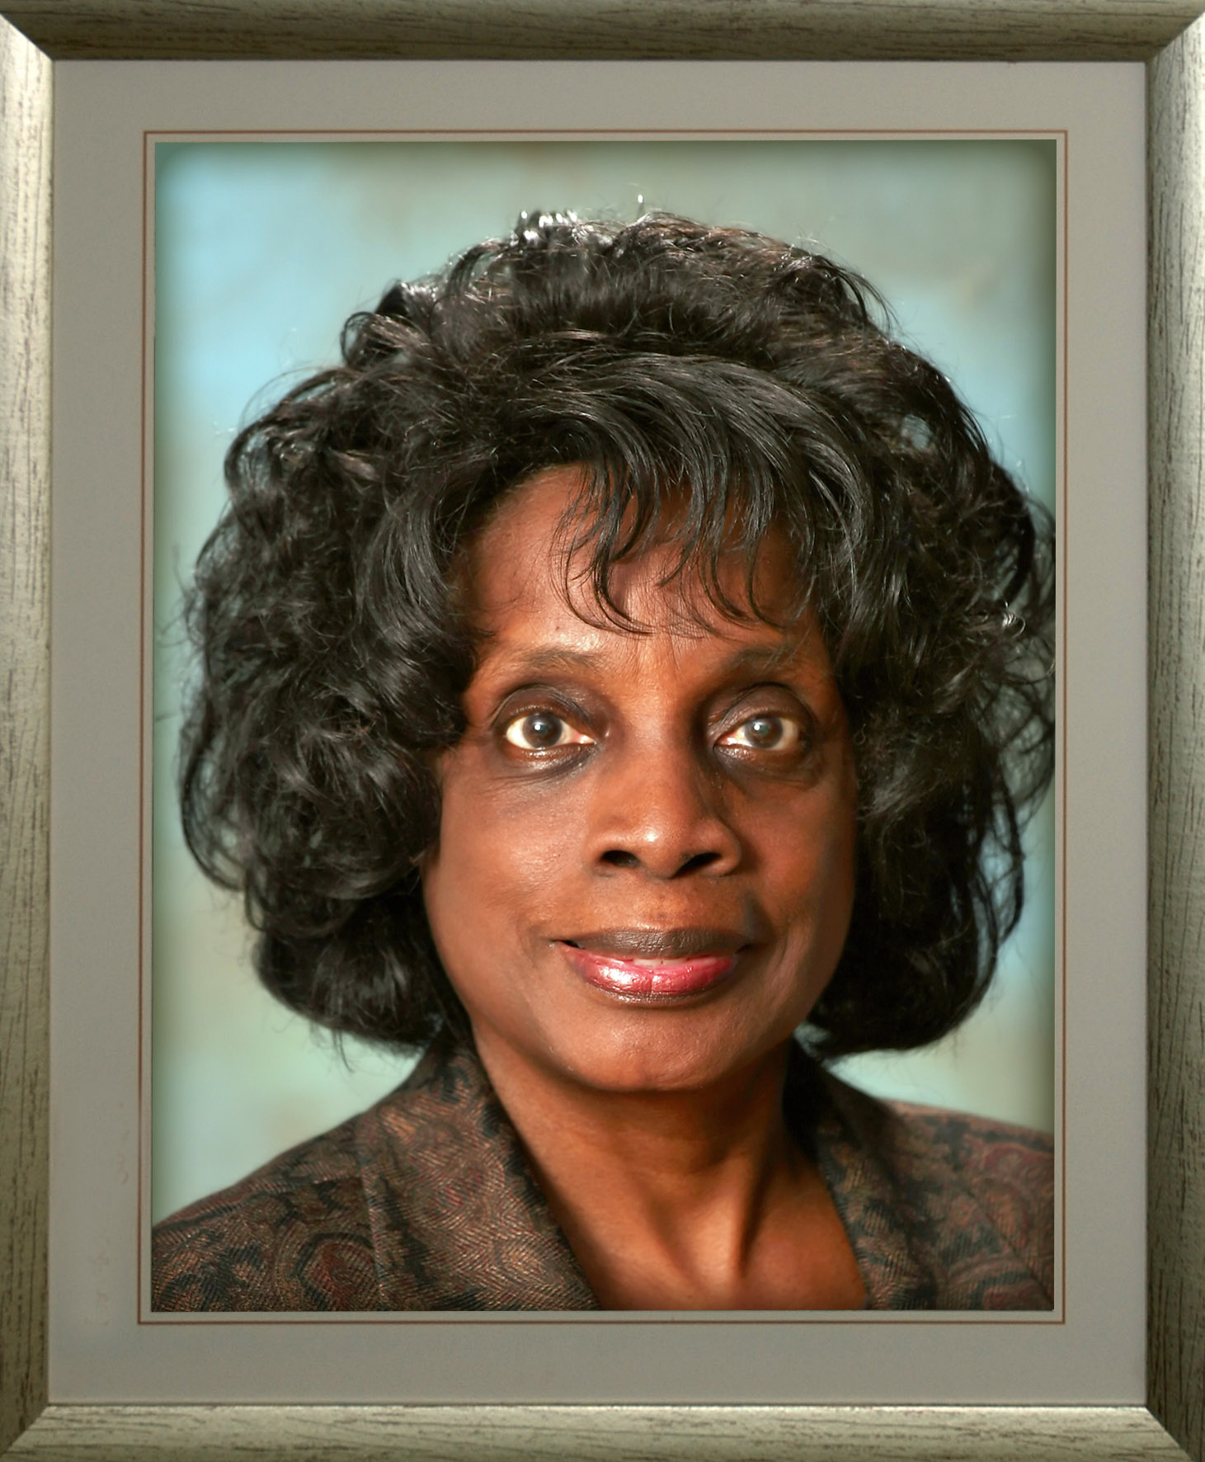
1997 – to the present
Flora Nwamaka Abaribe
Leader, mentor, educator, trainer. Responsible for helping destitute widows in Nigeria to have hope and a future, West-Central Africa Division.
Dr. Rosa Maria Taylor Banks
B.S., M.Ed., Ed.D., L.H.D.
Administrator, professor, speaker, writer, authority on diversity. First woman to serve as vice president of Oakwood College. General Conference associate secretary. Also served as general field secretary and officer of North American Division.

Slide 24
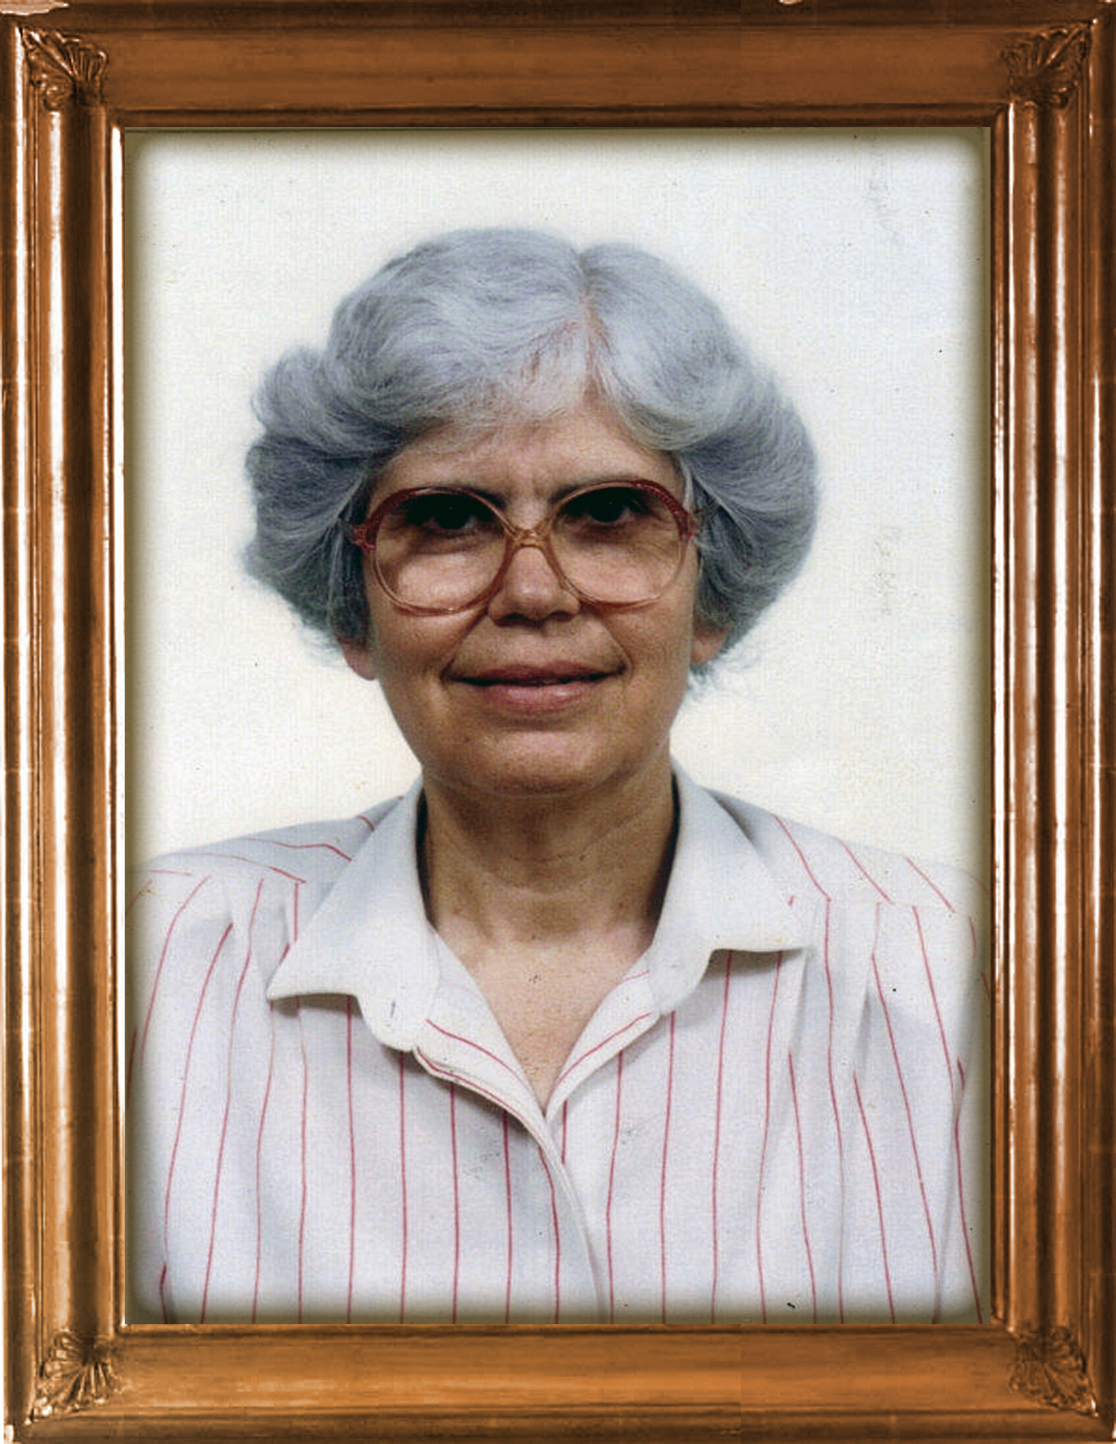
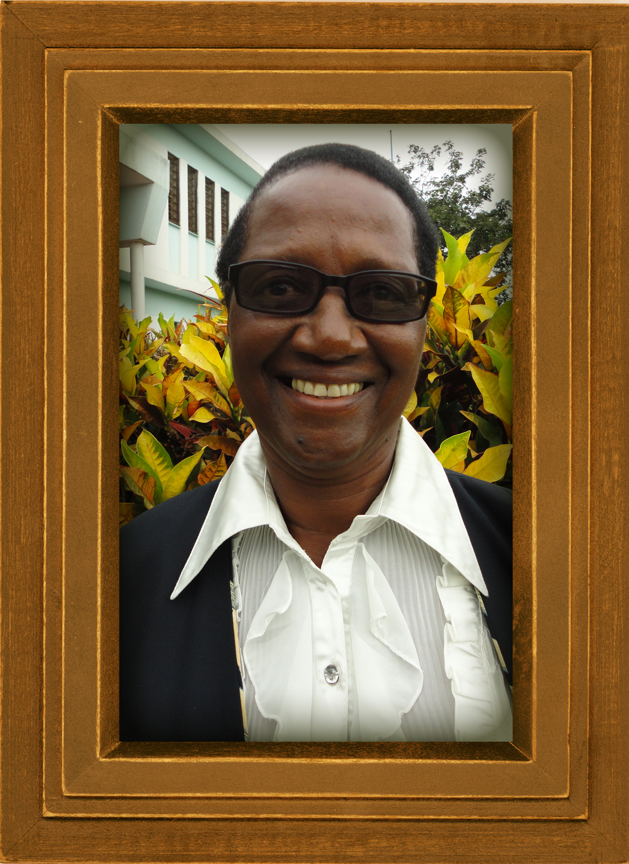
Miriam de Azevedo Berg
Educator, teacher, mentor, Children’s Ministries pioneer in South American Division. Frontier missionary in Mozambique under persecution. Dedicated her life to empower women to serve.
Agness Bakuluma Chirwa
Evangelist, teacher, mentor, entrepreneur, counselor. First volunteer Women’s Ministries director. Know in Zambia as ‘Mother General’ because of her leadership qualities, Southern Africa-Indian Ocean Division.

Slide 25
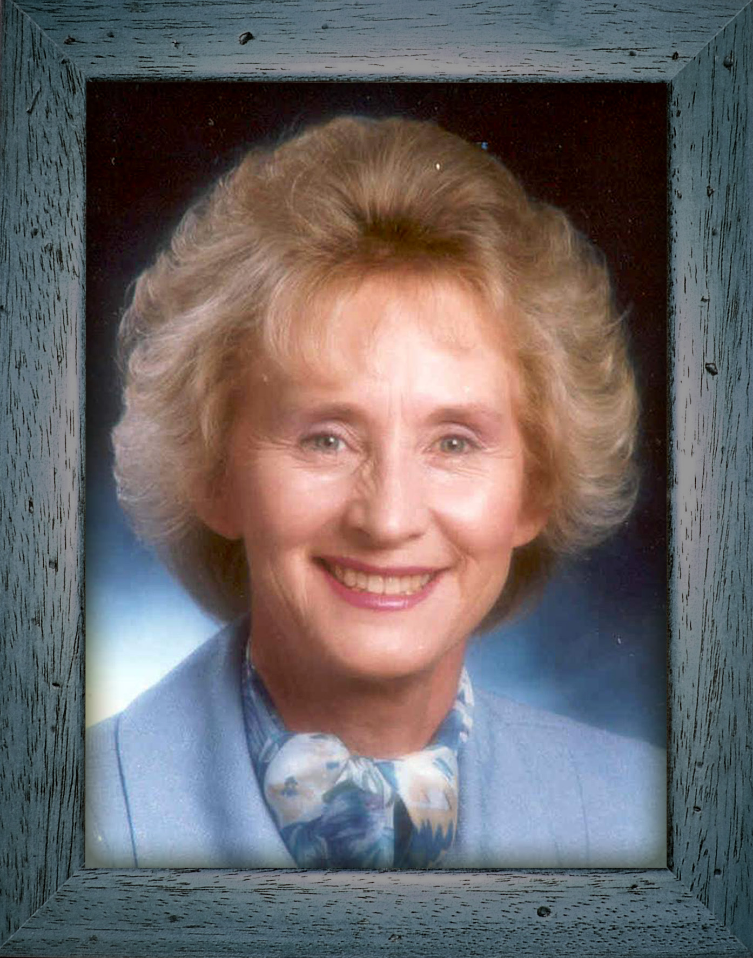
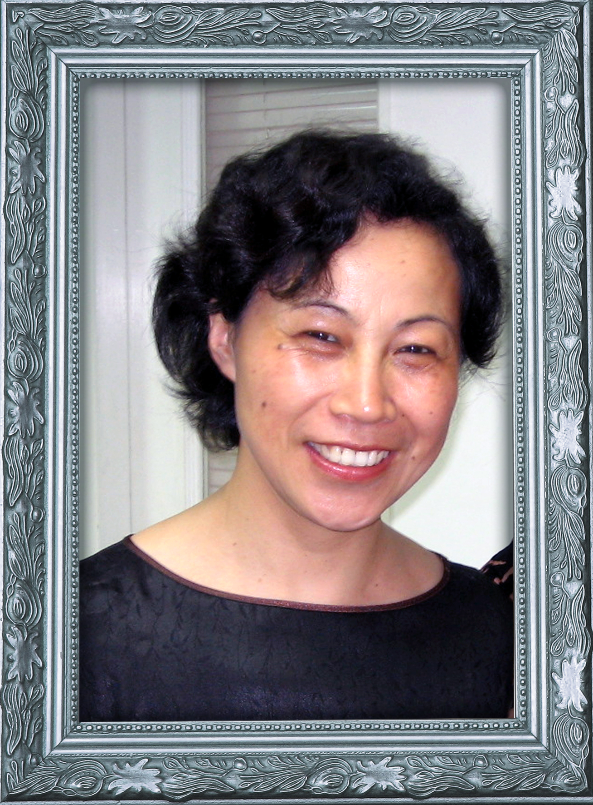
Carole Ferch-Johnson
Bible worker, evangelist, counselor, writer. Women’s Ministries pioneer in the South Pacific Division.
Hong, Xiao Mei
Pastor and evangelist. Raised up 800-member church congregation and training facility for Adventist leaders in China, Northern-Asia Pacific Division.

Slide 26
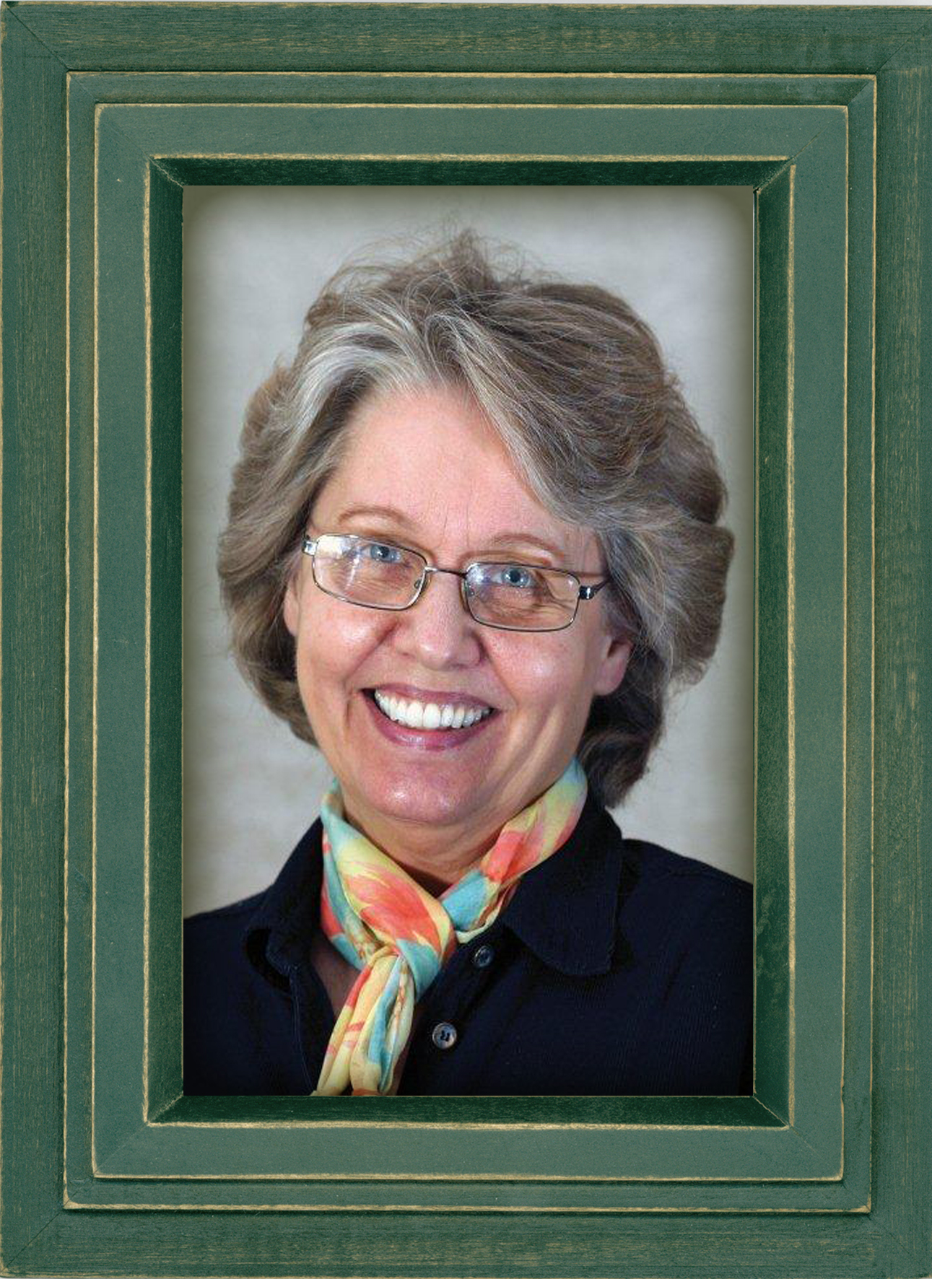
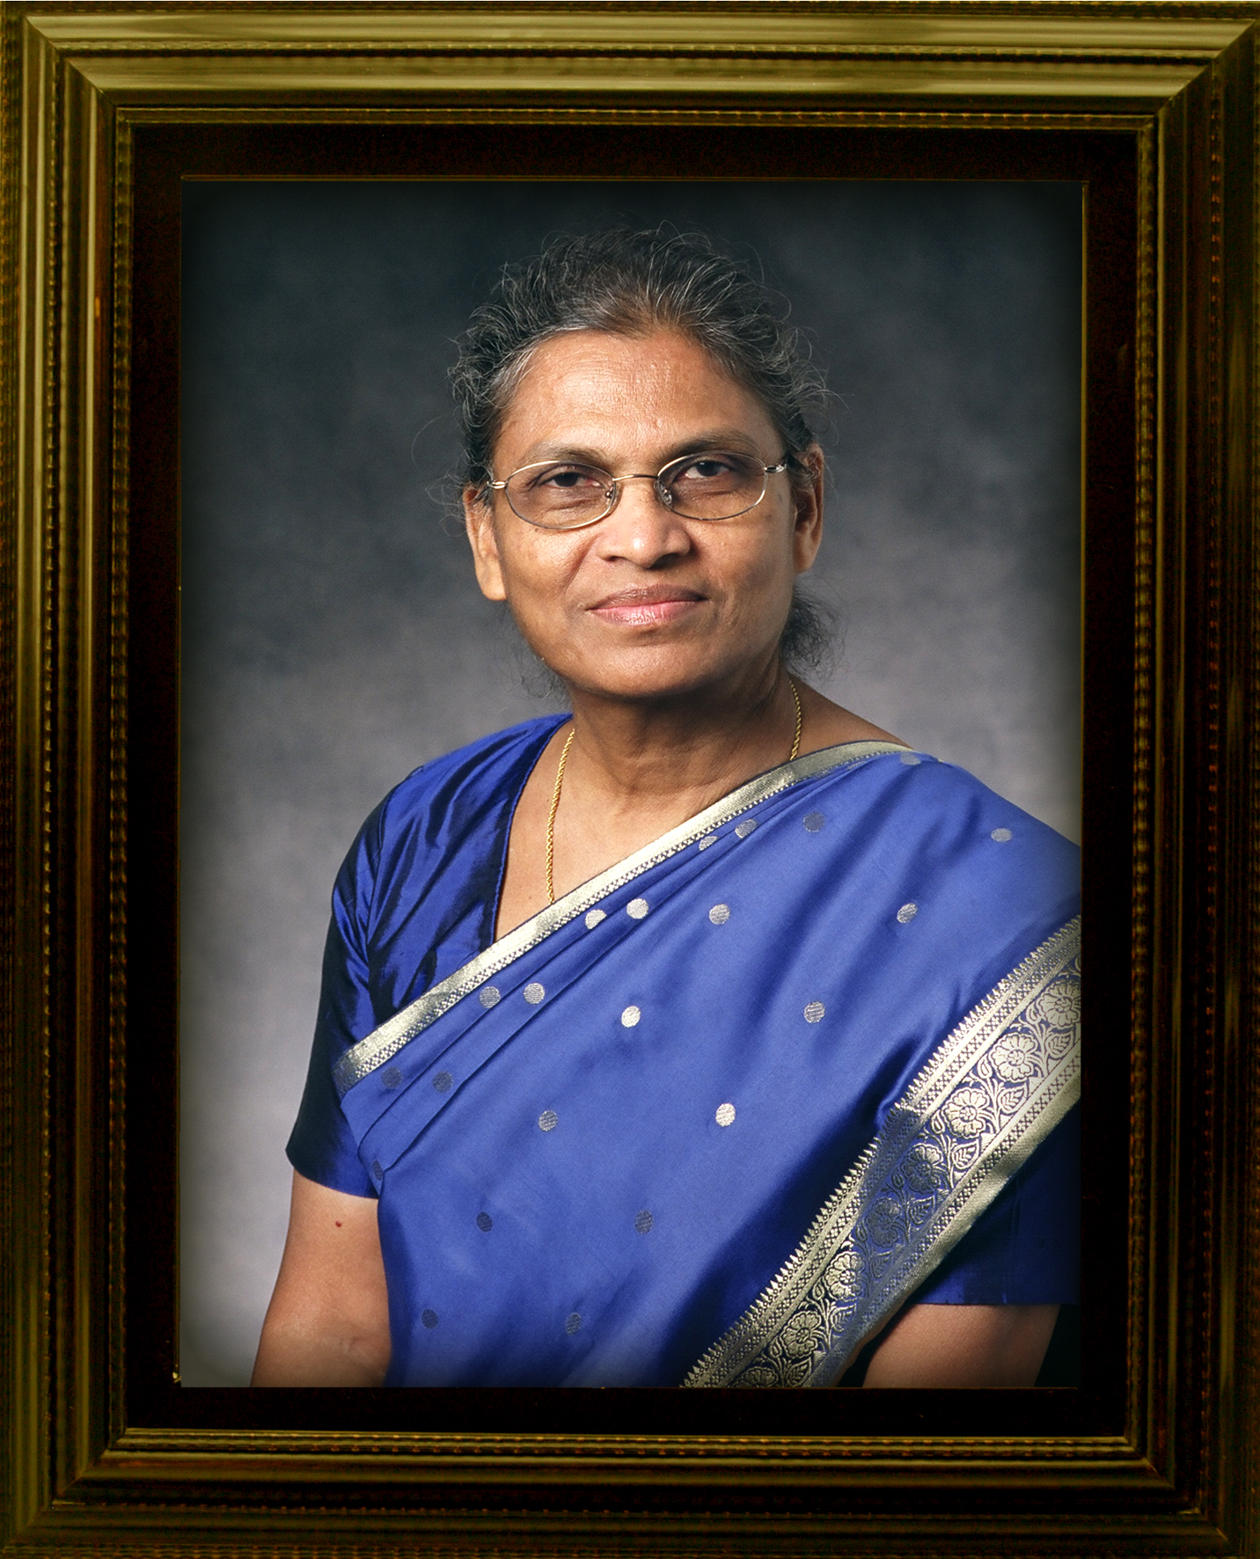
Birthe Kendel
Teacher, physiotherapist, counselor for victims of sexual abuse. First director of Women’s Ministries in the Trans-European Division. Missionary in many countries.
Hepzibah Kore
Teacher, evangelist, leader. Founder of adult literacy program in India, “Never Too Late to Learn,” helping more than 50,000 women and their families, Southern Asia Division.

Slide 27
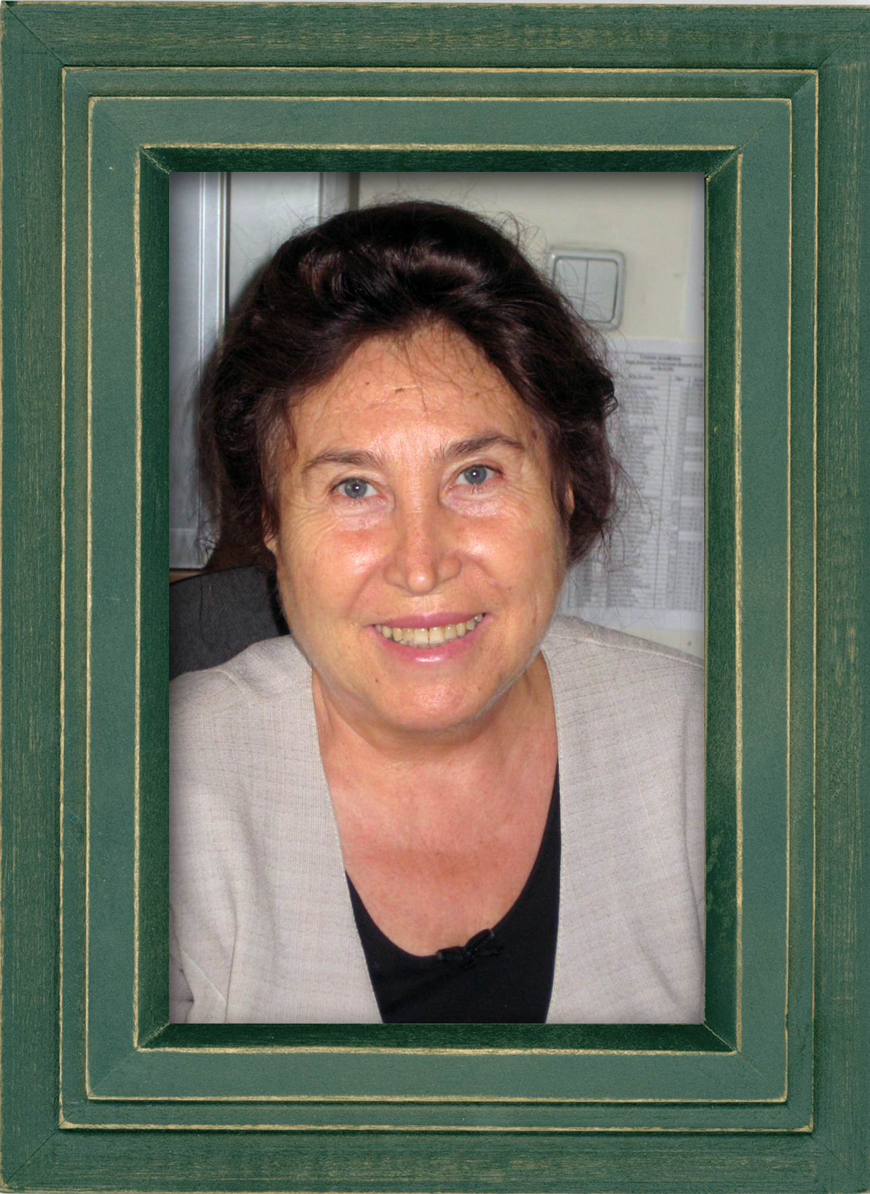
Jerusha Muga
Evangelist, writer. Union director for Women’s and Children’s Ministries and Sabbath School department. Ministers to dignitaries in Kenya, East-Central Africa Division.
Olga Murga
Evangelist, preacher, church planter. Women’s Ministries pioneer in Russia. Through her more than 70 evangelistic programs, 3,038 people were baptized in Euro-Asia Division.

Slide 28
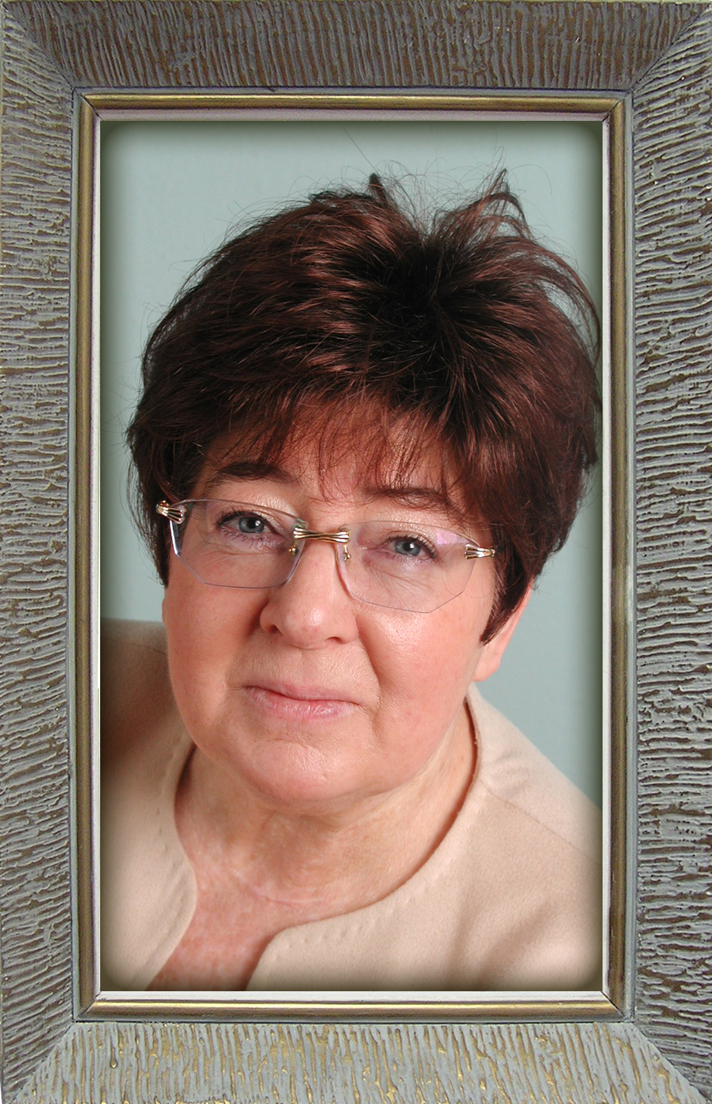
Ingrid Naumann
Evangelist, motivator, mentor. Pioneer in establishing Women’s Ministries, especially in German-speaking countries, Inter-European Division.
Esther Dias Sablon
Educator. First woman president of Cuba Adventist Theological Seminary, Inter-American Division.

Slide 29
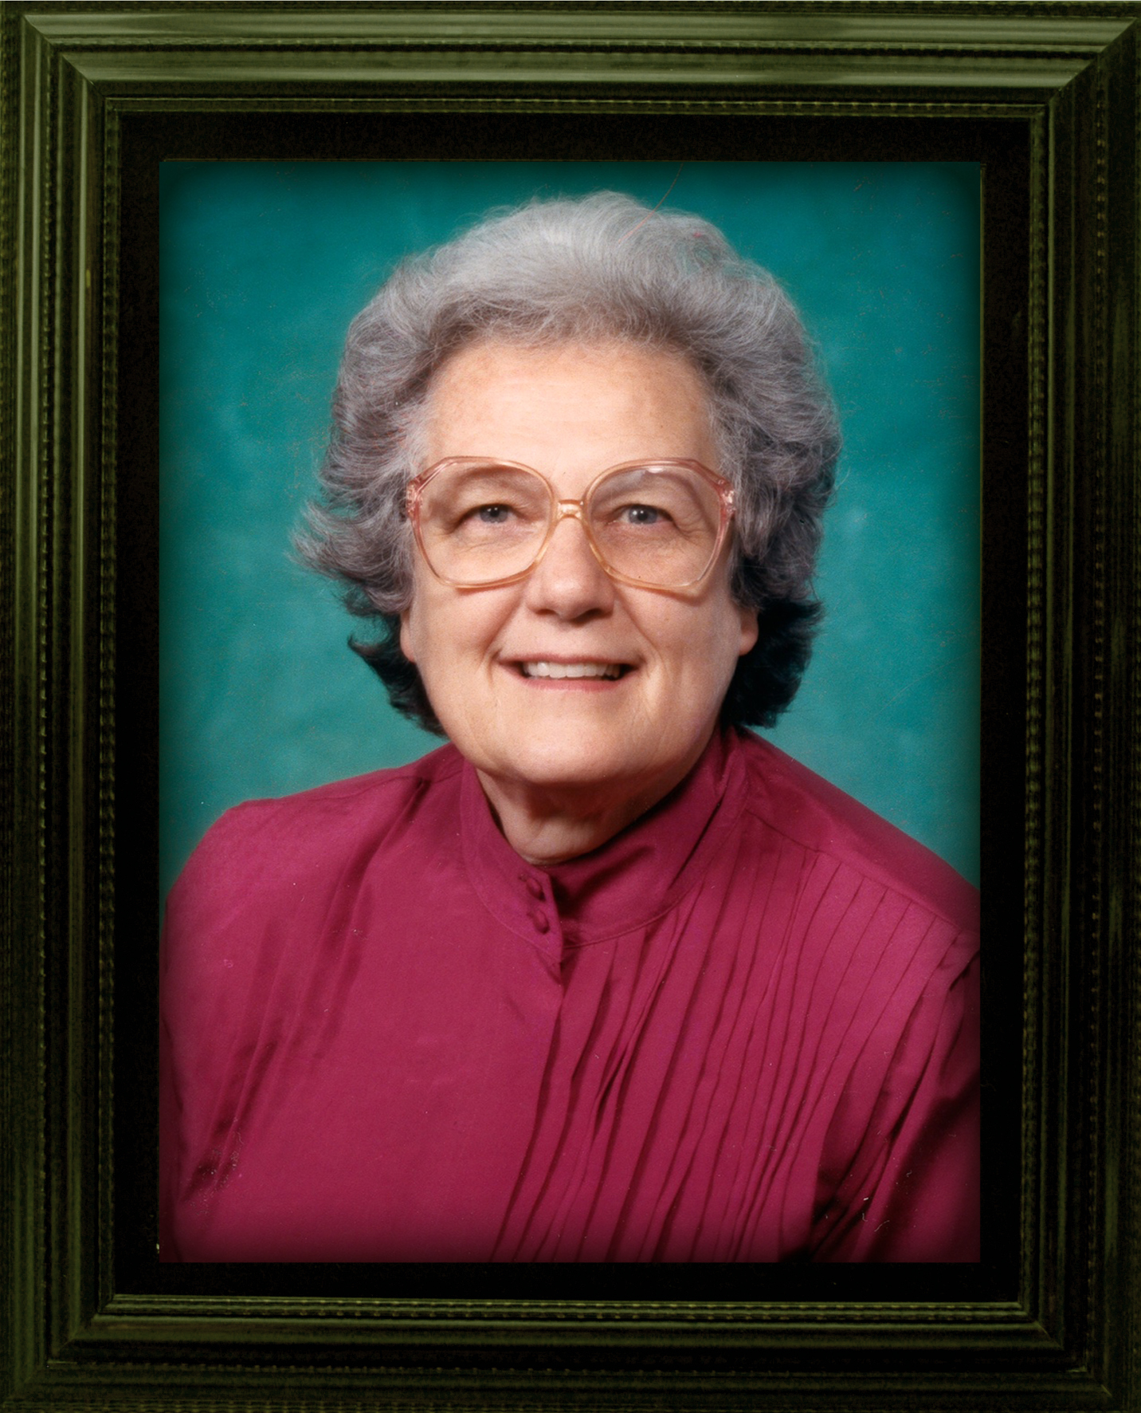
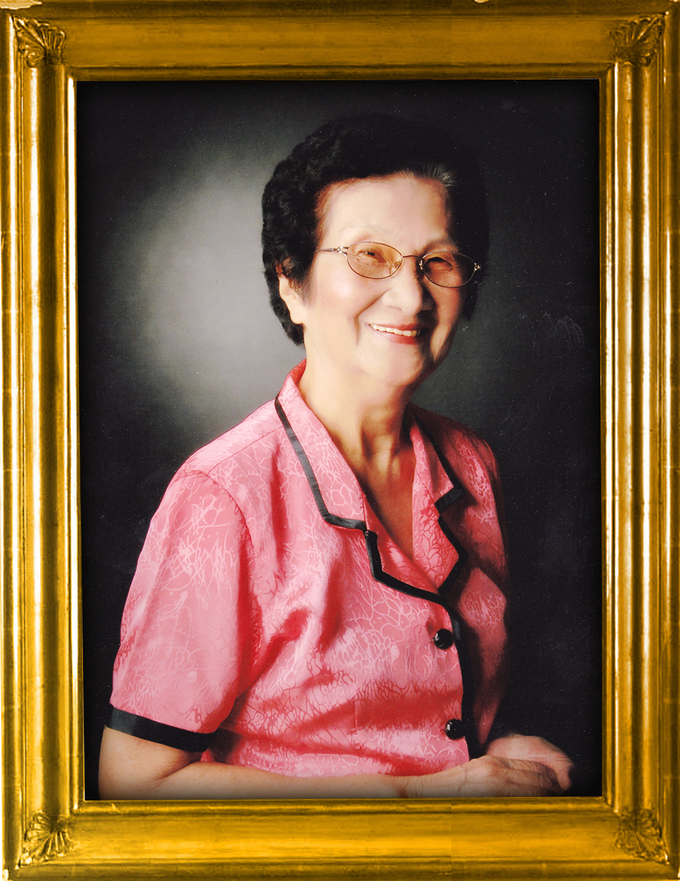
Elizabeth Sterndale
Registered nurse. First director of Women’s Ministries in North American Division and general field secretary of the division.
Consolacion Tauro
Leader, church elder, preacher, educator. Women’s Ministries pioneer in the Philippines. Served for 47 years in Southern Asia-Pacific Division.

Slide 30
General Conference
Department of
Women’s Ministries
https://women.adventist.org

